Slide 1
Test of reflective materials on lead surface
Botan Wang
Tsinghua University

Slide 2
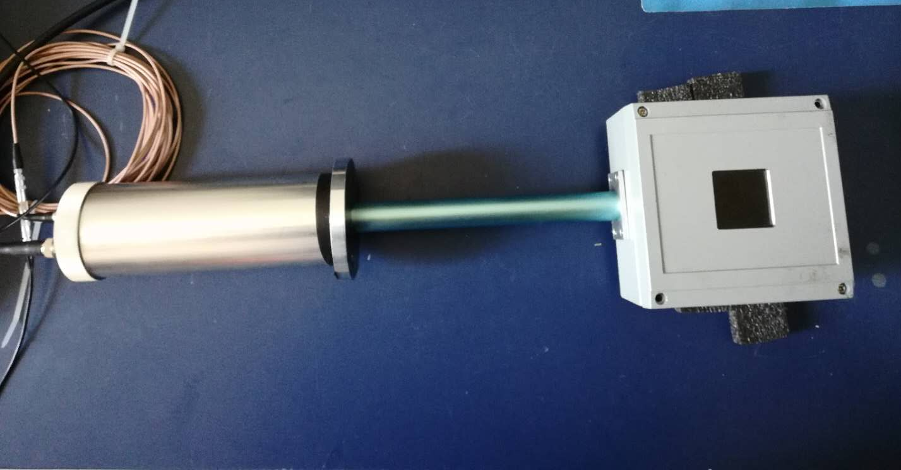
Test devices
C.A.E.N
N470
+HV
PMT
V
Beta source
Signal

Slide 3
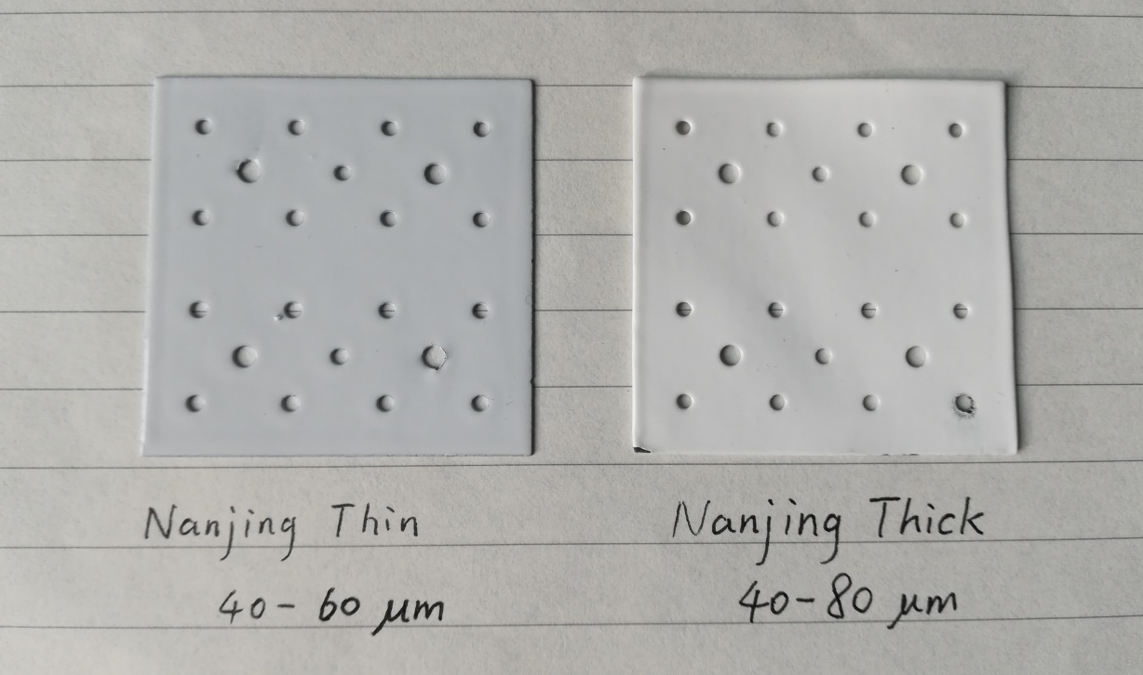
Lead sheet samples
New samples:
Nanjing thin sheets (40-60μm)
Nanjing thick sheets (40-80μm)
For comparison:
Old smooth surface (36.5μm)
New smooth surface (37.5μm)
Thick TYVEK (62.5μm)

Slide 4
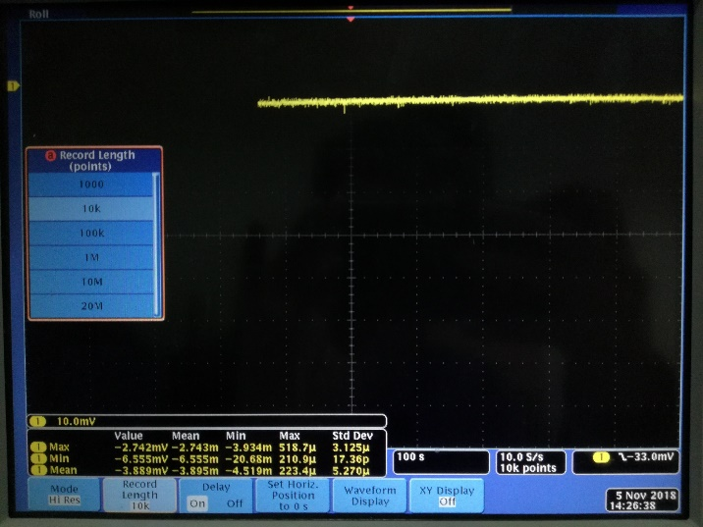
Signal readout
Multimeter
Read the voltage variation range
Difficult to tell the difference
Digital Phosphor Oscilloscope (DPO4034B)
High resolution mode: average output in a period of time, more smooth signals;
1MΩ impedance to get the measurable voltage;
Sampling frequency: 10 Samples/s, total number 10K for calculation

Slide 5
Test result
 | Multimeter/mV | DPO/mV | Former Test/V
Old smooth surface | 41 (39~43) | 3.924 | 0.45 (0.44~0.49)
Nanjing thin Surface | 40 (38~42) | 4.127
Nanjing thick Surface | 40 (37~43) | 3.749
New smooth surface | 36 (33~39) | 3.463 | 0.45 (0.43~0.49)
Thick TYVEK | 47 (44~50) | 4.177 | 0.54 (0.52~0.56)
no resource | 3 (2~4) | 0.918 | 0.04 (0.03~0.05)

