Slide 1
Threshold testing
of the shashlyk module
Liping Wang Ye Tian
Cunfeng Feng Bo Yu
Shandong Univercity
Mar. 28th ,2019

Slide 2
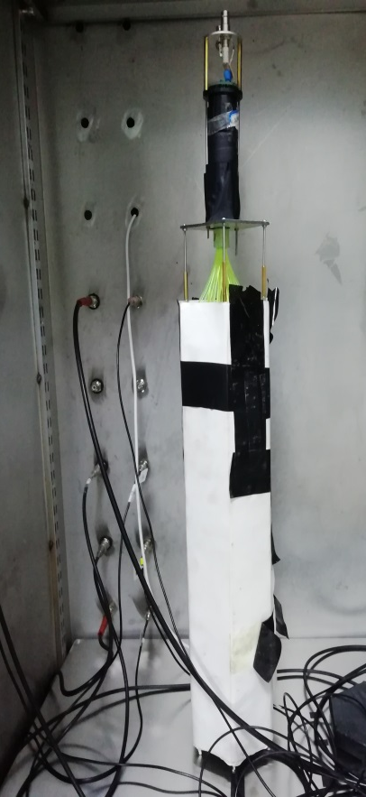
Module threshold test
Module
Low threshold discriminator
counter

Slide 3
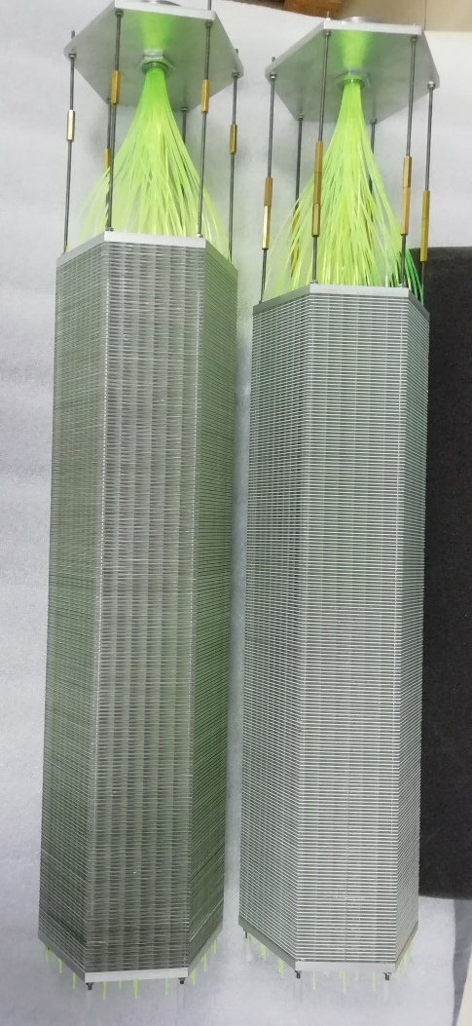
Test module
Left: SDU 5(Tyvek are added between the layers,no wrapping paper)
Right:SDU 4(Lead is coated with the powder, no wrapping paper)
SDU 3(module side has been painted )

Slide 4
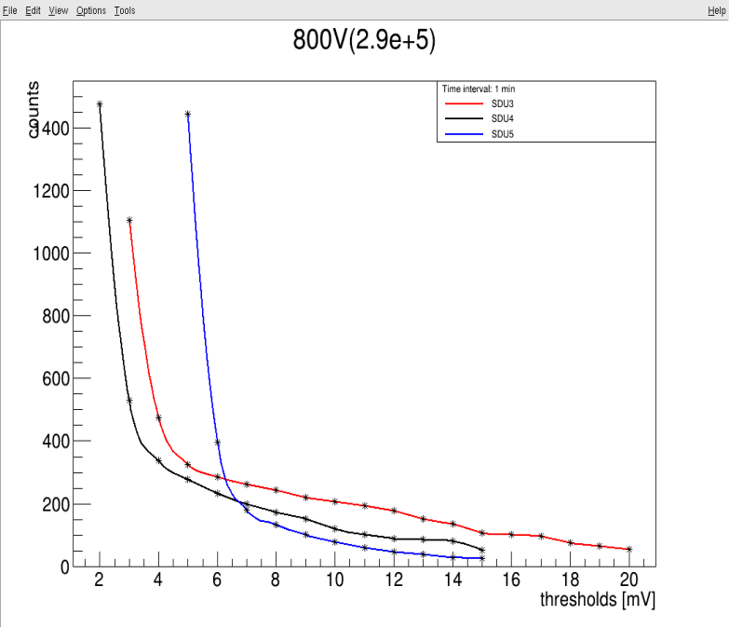
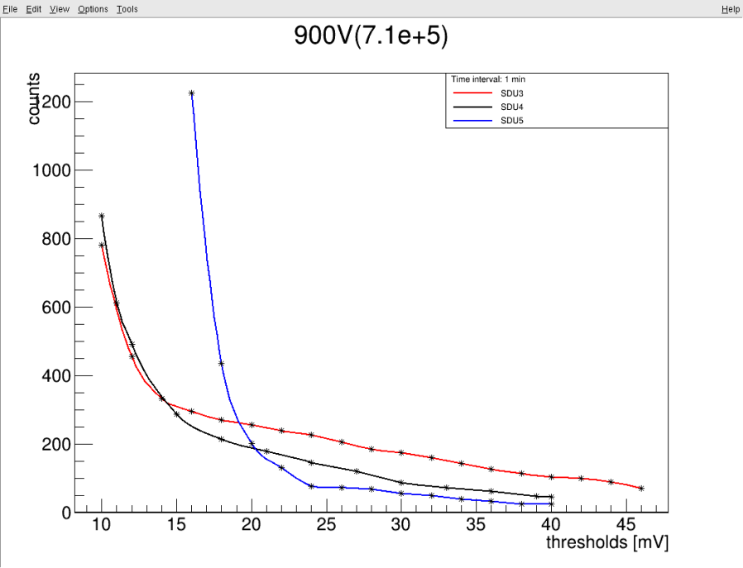
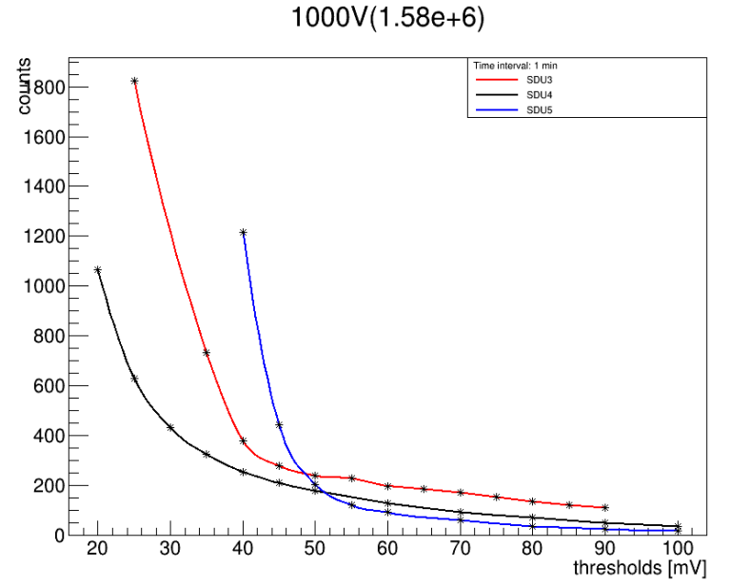
Test result
Compare the three modules under same high voltage
The SDU 5 has the most small signals.
The SDU 3 has the most large signals.
The SDU 3 has the hightest light yield.

Slide 5
Test result
The threshold was taken at the counts’ mutation
Module threshold HV(Gain) (counts) | SDU 3 | SDU 4 | SDU5
800V(2.90e+5) | 4mV(474) | 3mV(529) | 6mV(397)
900V(7.10e+5) | 12mV(455) | 12mV(492) | 18mV(435)
1000V(1.58e+6) | 35mV(734) | 30mV(430) | 45mV(441)
Under the same high voltage,the threshold value of the SDU5 is the highest,and SDU4 has the minimum threshold.

Slide 6
Test summary
• The module 5 has the highest dark noise rate. And, module 3 has the highest light yield.
• In the cosmic ray environment, the background of the calorimeter is less.
• At different high voltages, the dark noise of PMT is very small, and we can ignore it.

Slide 7
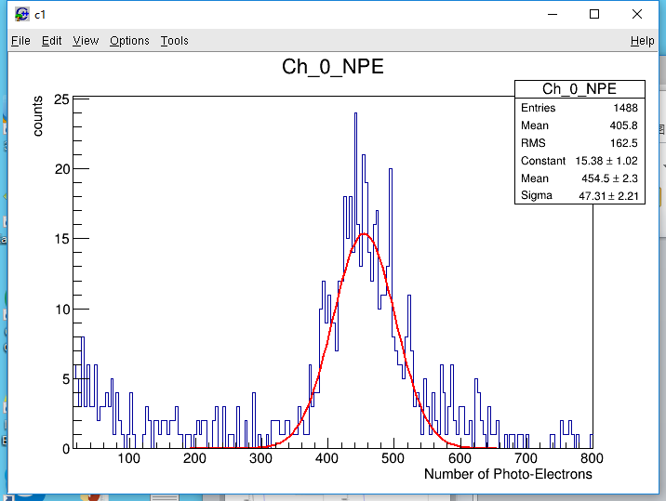
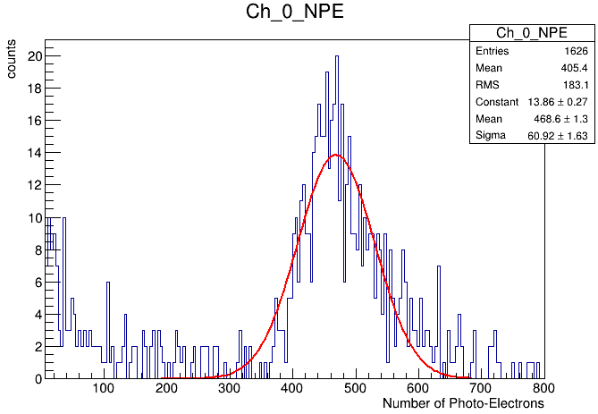
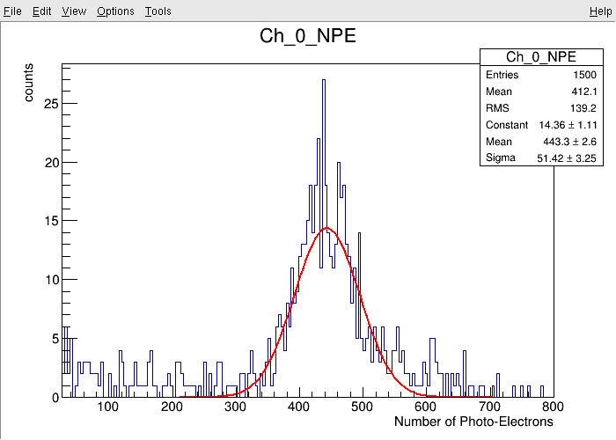
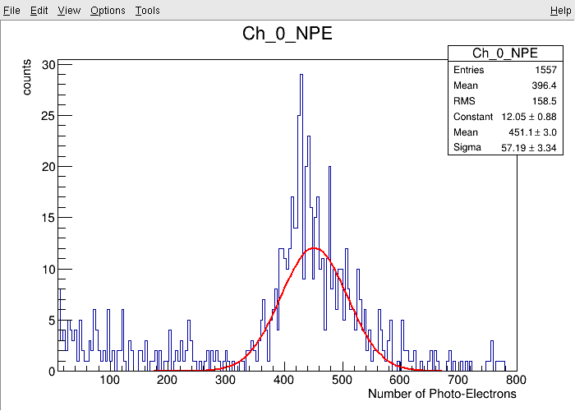
Photon yield of module 3 test result
900V(7.1e+5)
1000V(1.58e+6)
NPE=454.5
NPE=468.6
The light yield is almost the same
1100V(3.26e+6)
1160V(4.73e+6)
NPE=443.3
NPE=451.1

Slide 8
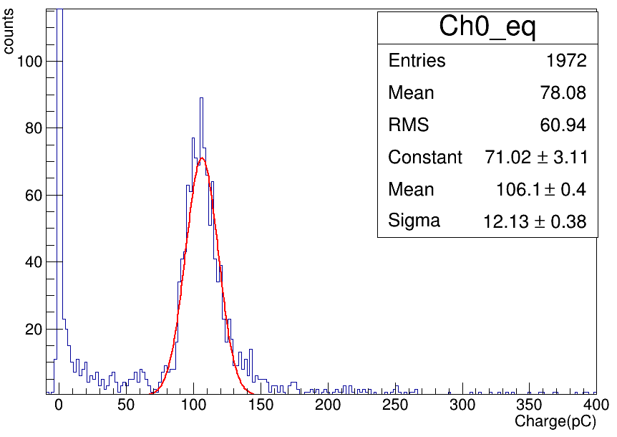
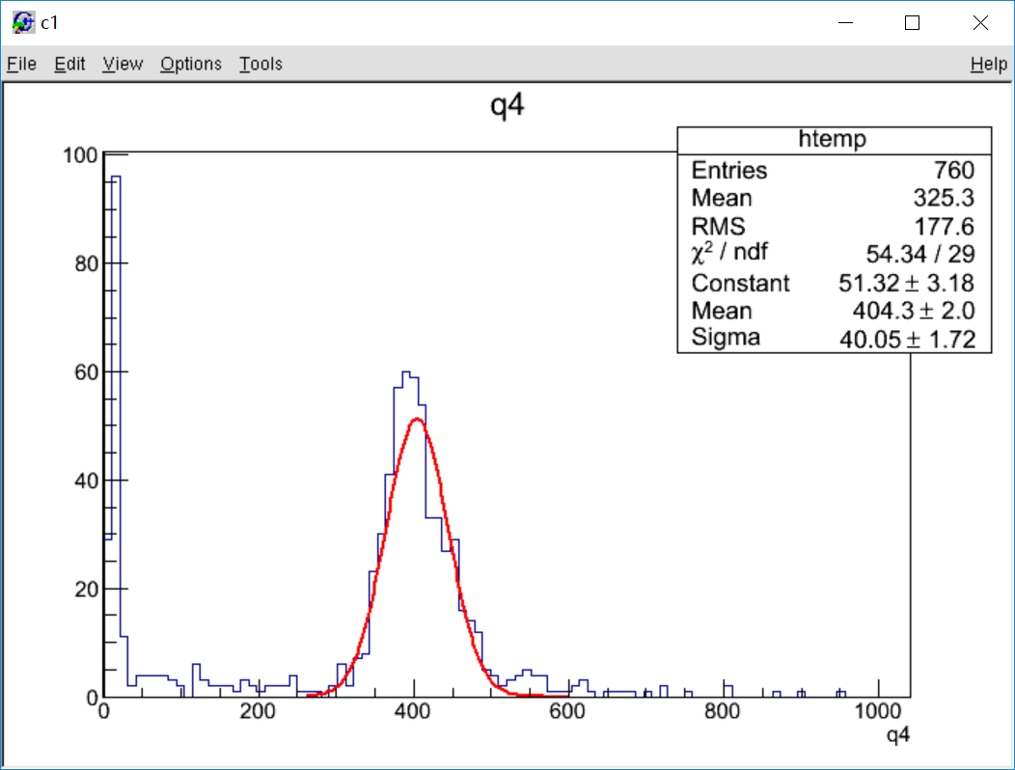
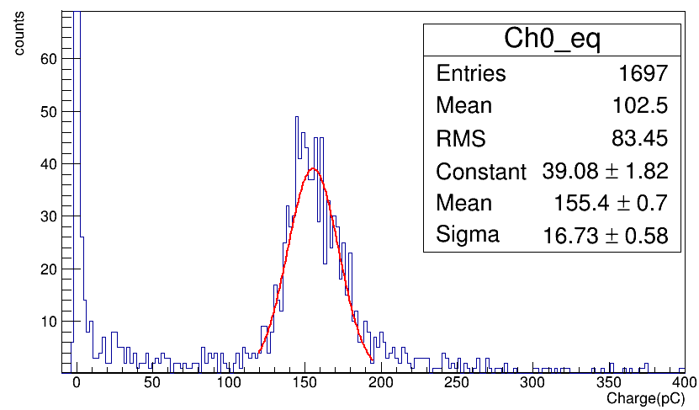
Previous test results
HV: 900V
2017.1.12
2018.1.11
HV: 950V
HV | Gain(*10^6) | Charge(pC) | NPE
900 | 1.35 | 106.1 | 491.2
950 | 2.01 | 155.4 | 483.2
NPE = 491.3 (with Gain=5*10^6)

Slide 9
Thank you!

