Slide 1
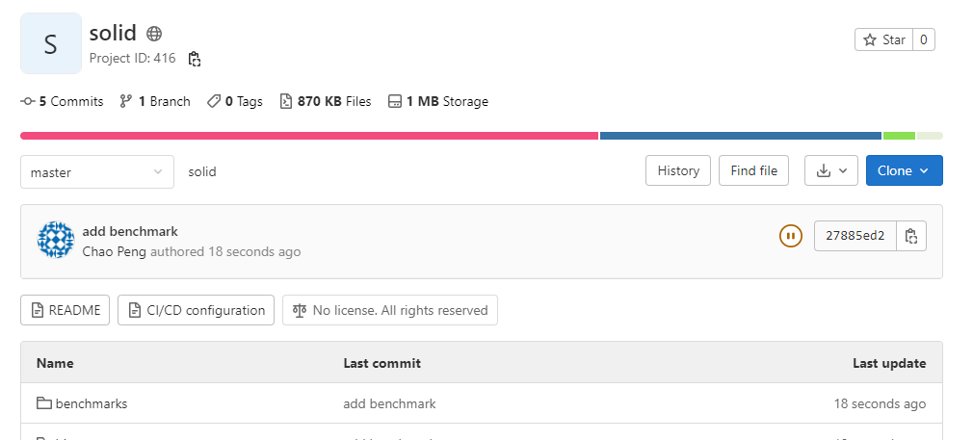
Running SoLID benchmark
SoLID in DD4Hep + Juggler (Gaudi)
https://eicweb.phy.anl.gov/EIC/detectors/solid

Slide 2
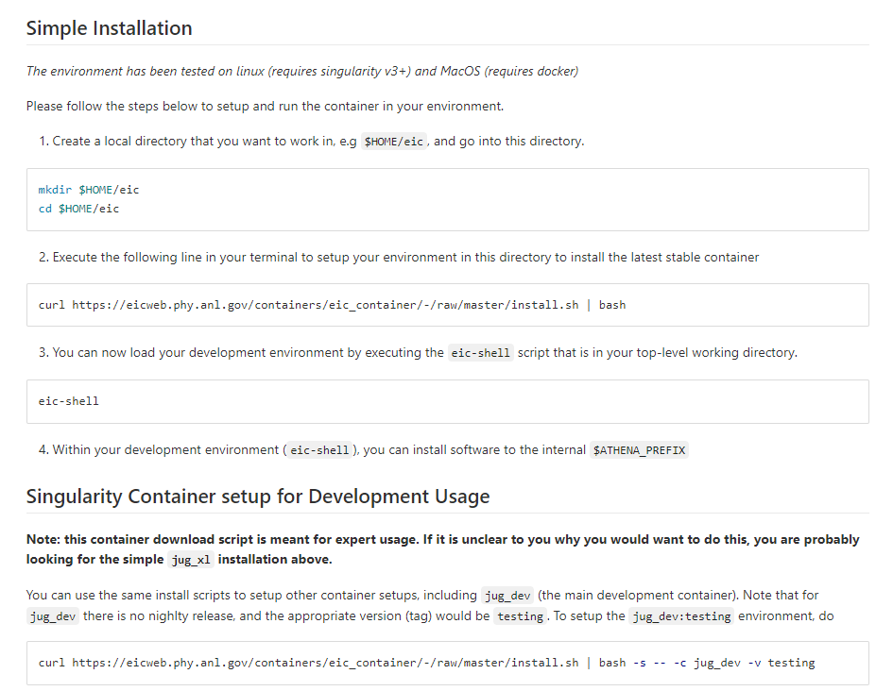
Installing EIC container
https://eicweb.phy.anl.gov/containers/eic_container

Slide 3
Installing Data Model and Juggler
In eic-shell
Data model (EICD)
git clone https://eicweb.phy.anl.gov/EIC/eicd.git
cd eicd
mkdir build && cd build
cmake .. –DCMAKE_INSTALL_PREFIX=$ATHENA_PREFIX –DBUILD_DATA_MODEL=ON
make –j4 install
Analysis framework (Juggler)
git clone https://eicweb.phy.anl.gov/EIC/juggler.git
cd eicd
mkdir build && cd build
cmake .. –DCMAKE_INSTALL_PREFIX=$ATHENA_PREFIX
make –j4 install

Slide 4
Set Environment Variables
Set some environment variables for benchmark
JUGGLER_DETECTOR=solid
Xml file name
DETECTOR_PATH=<path_to_solid_repo>
Path to solid repository
JUGGLER_INSTALL_PREFIX=$ATHENA_PREFIX
If you installed juggler in $ATHENA_PREFIX

Slide 5
Run benchmark
In solid repository
python benchmarks/ecal/run_emcal_benchmarks.py barrel --particle "electron" -n 100 -t "barrel_electron" --pmin 5.0 --pmax 5.0 --angmin 45 --angmax 135
Results in gen_data, sim_data, rec_data

