Slide 1
Questions we would like to ask at the TDIS collaboration meeting
Arun Tadepalli – JLab
Steve Wood – JLab
Ole Hansen – JLab

Slide 2
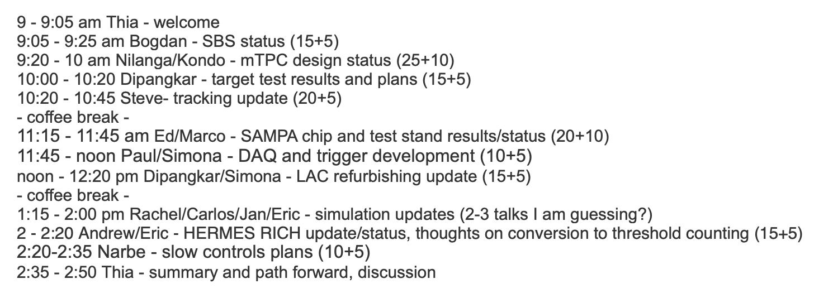
Rough meeting agenda

Slide 3
mTPC design – Nilanga/Kondo
Minimum pad size (any physical limitations from DAQ channels/ring?)
Max number of pads we can assume (any physical limitations?)
Efficiency achieved so far/pad (from studies in Hall A)
Time resolution/pad?
Are there DAQ limitations on the total number of pads per ring per mTPC?
Double pulse resolution, what can we still learn in case we observe a double pulse? Does the distortion in the shape achieved while shaping the pulse affect track reconstruction?
Per pad/dead time?
How can we keep the field uniform around the edges of the mTPC pads?

Slide 4
Target - Dipangkar
How much energy does a low momentum proton lose while coming out from the target region?

Slide 5
Track reconstruction – Steve, Ole and Arun
Steve’s code needs a Monte Carlo production to test. Currently his code doesn’t include:
  Energy loss
  Kalman Filter
  Missing pads in tracks
Backgrounds? Where can we find a list of all of the physics backgrounds for piTDIS and kTDIS?
How do we go about showing that we have achieved track reconstruction?
Future plans: SBS uses Hall A analyzer and it would be nice to integrate the mTPC software

Slide 6
SBS arm – Simona, Paul Reimer, Eric
What is the time resolution for the electrons?
What is the z resolution for the electrons?
Spec sheet for this arm? Should we make one and post it to the TDIS wiki page?
  Which detectors provide the PID for electrons and how well are they expected to perform?

Slide 7
Digitization – Rachel/Carlos/Jan/Eric
What are the parameters necessary for digitization?
  padID
  ringID
  planeID
  rocID, tdcID (trigger/DAQ type variables)
  Time
  Amplitude
  Any others?
How applicable is the digitization for the readout from the mTPC from the recent GEM run in Hall A?

Slide 8
Simulations – Carlos/Rachel
Is a list of all parent particles (and the relevant truth information) available for our simulations?

