Slide 1
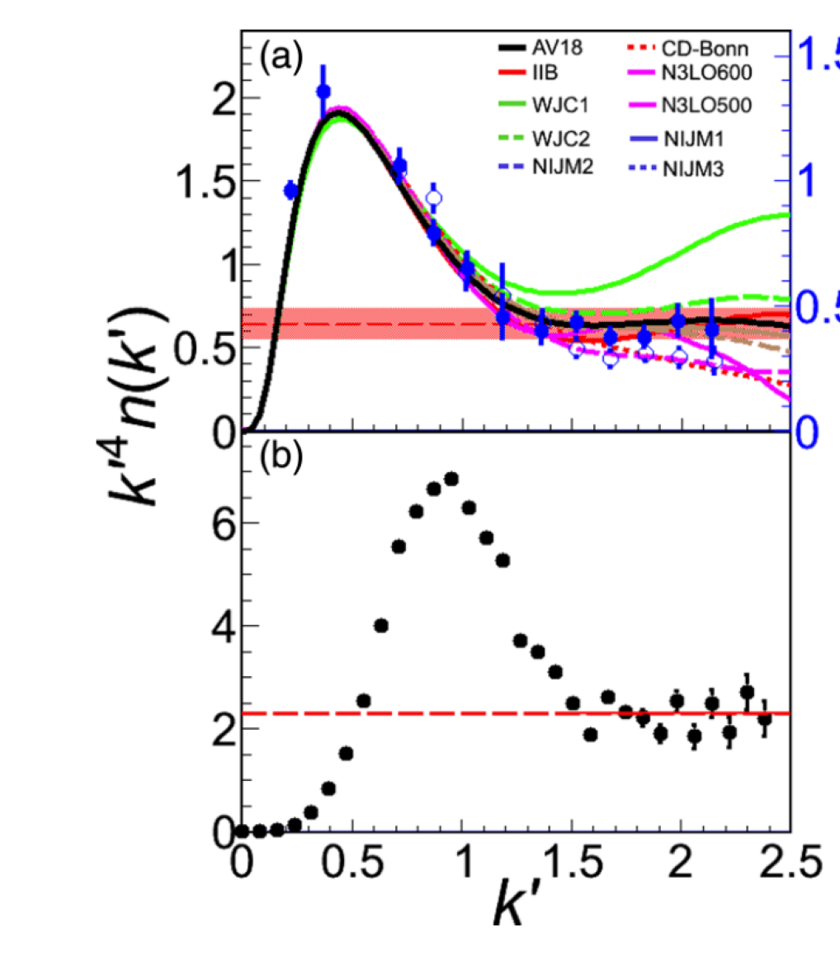
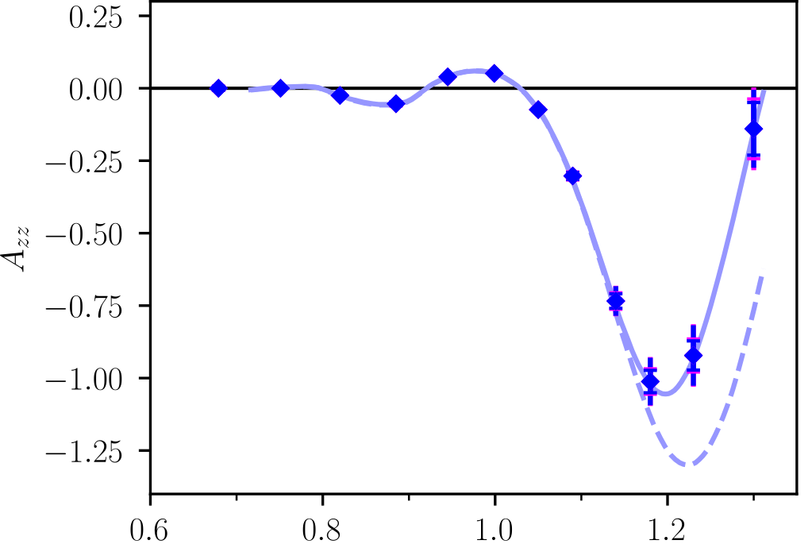
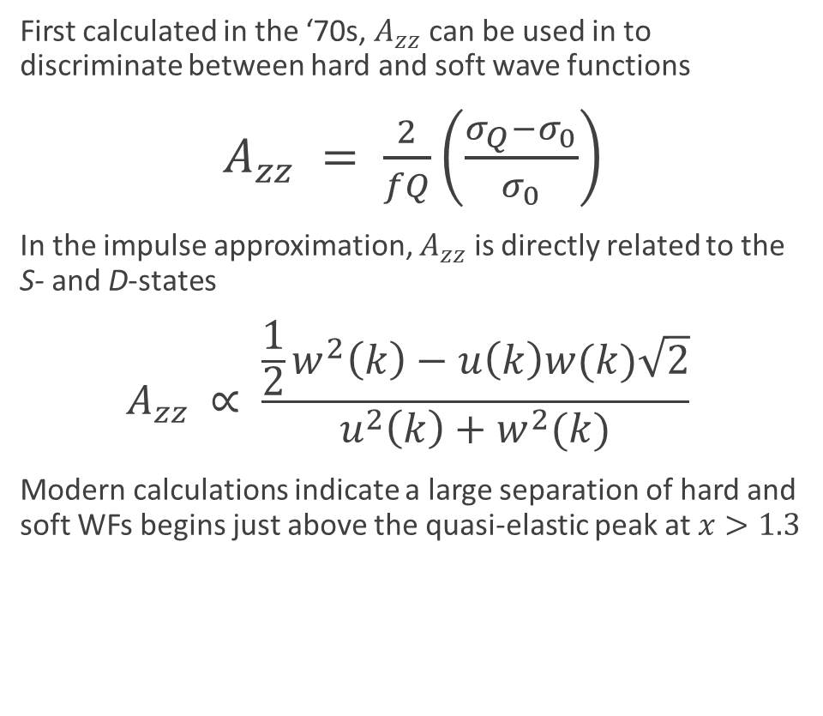



Deuteron Wavefunction
“There is a strong need for models of the deuteron wave function that are both realistic and relativistic.”
Unpolarized
- J. Terry, G. Miller, arXiv:1603.07032 (2016)
$$k^{′}4n(k^{′})$$
First calculated in the ‘70s, $A_{zz}$ can be used in to discriminate between hard and soft wave functions
$A_{zz} = \frac{2}{fQ}\left(\frac{σ_{Q}−σ_{0}}{σ_{0}}\right)$
In the impulse approximation, $A_{zz}$ is directly related to the S- and D-states
$$A_{zz} ∝ \frac{\frac{1}{2}w^{2}\left(k\right)−u\left(k\right)w(k)\sqrt{2}}{u^{2}\left(k\right)+w^{2}(k)}$$
Modern calculations indicate a large separation of hard and soft WFs begins just above the quasi-elastic peak at $x>1.3$
Tensor Polarized
$$k′$$
$$S→u\left(k\right)$$
$$D→w\left(k\right)$$
~60%
Projected
AV18
CDBonn
LL Frankfurt, MI Strikman, Phys. Rept. 76 215 (1981)
M Sargsian

Slide 2
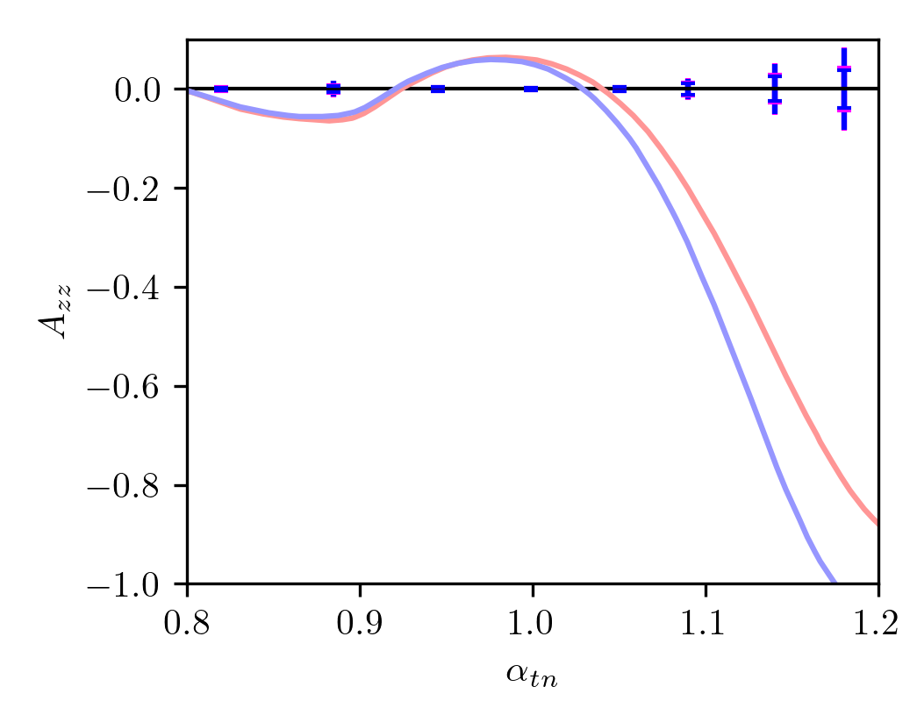
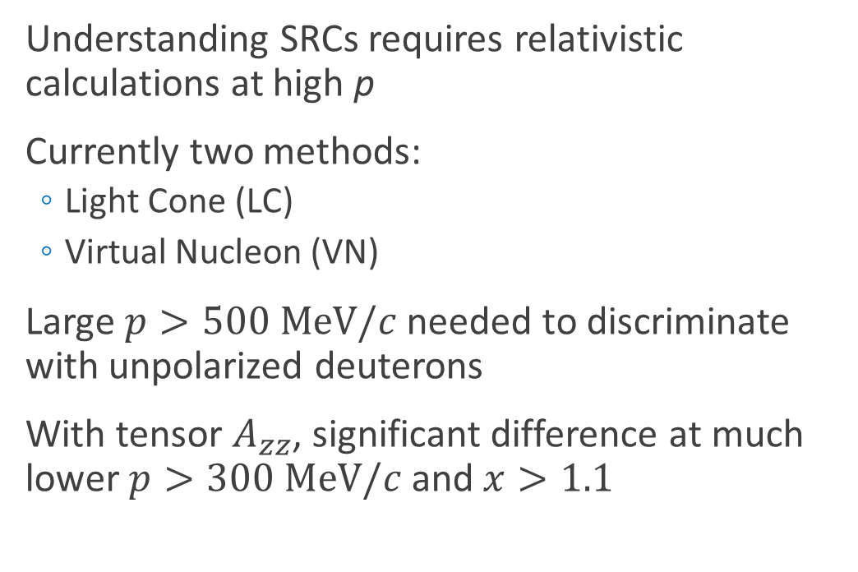
Relativistic NN Bound System
“There is a strong need for models of the deuteron wave function that are both realistic and relativistic.”
- J. Terry, G. Miller, arXiv:1603.07032 (2016)
Understanding SRCs requires relativistic calculations at high p
Currently two methods:
  Light Cone (LC)
  Virtual Nucleon (VN)
Large $p>500 MeV/c$ needed to discriminate with unpolarized deuterons
With tensor $A_{zz}$, significant difference at much lower $p>300 MeV/c$ and$x>1.1$
Projected
Light Cone
Virtual Nucleon
M Sargsian, Tensor Spin Observables Workshop (2014)

Slide 3
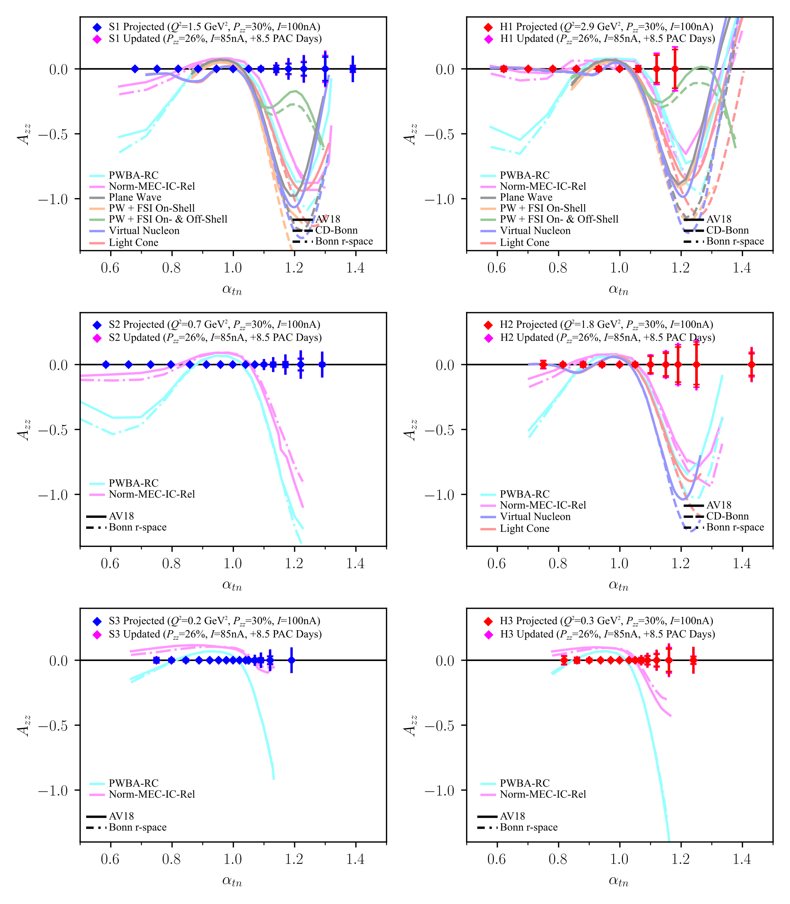
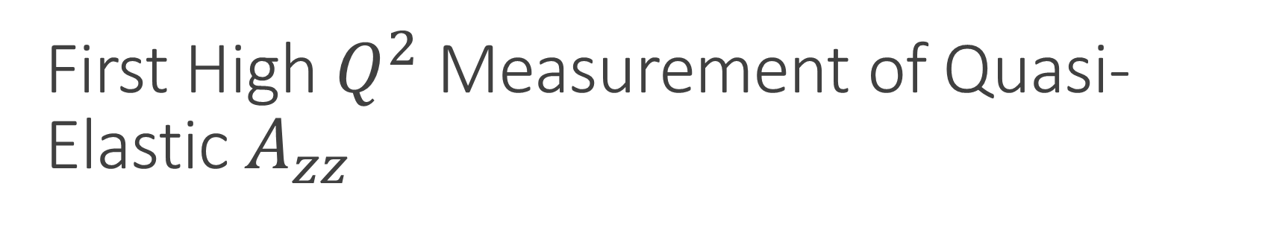
First High $Q^{2}$ Measurement of Quasi-Elastic $A_{zz}$
No current quasi-elastic tensor measurements
Sensitive to effects that are very difficult or impossible to measure with unpolarized or vector polarized deuterons
Large 10-100% asymmetry
Decades of theoretical interest that we can only now probe with a high-luminosity tensor-polarized target (same as b₁ experiment)
  Better understanding of s/d, SRCs & pn dominance, differential light cone & virtual nucleon models
Importance ranges from understanding short-range correlations to the equations of state of neutron stars
Also: T₂₀ over widest Q² range
  Important cross-check of Hall C high Q² data

Slide 4
New Information since Original Proposal
  C1 Conditional Status (P_{zz} ≥ 30%) Removed in Aug. 2022 [Conditional Review]
    Review committee noted that “…the UVA and UNH groups have made substantial strides beyond previous work, particularly in the analysis of the deuteron lineshape following RF manipulation.”
    Conditional Review noted that though P_{zz}>30% was demonstrated, it would be difficult to maintain in experimental conditions
    We have increased our beam time request (+8.5 PAC days) to achieve similar physics results at a more modest P_{zz} = 26%

Slide 5
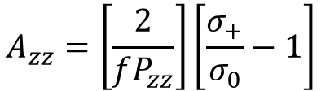



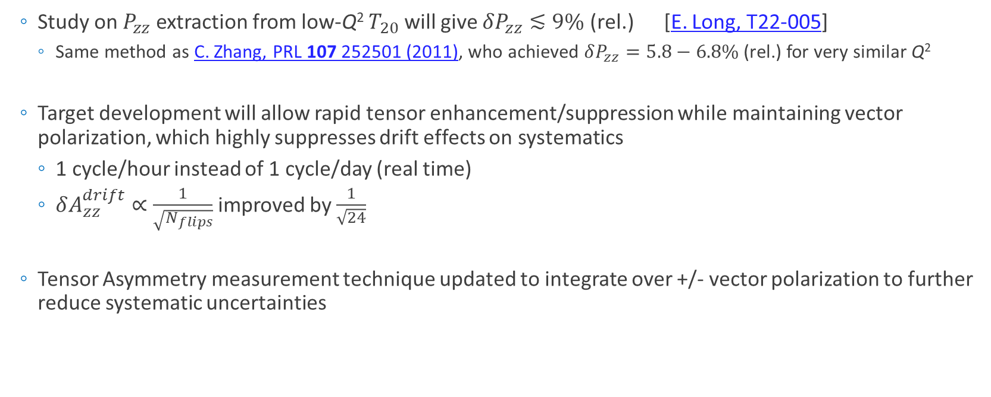
New Information since Proposed
  Study on $P_{zz}$ extraction from low-Q² $T_{20}$will give $δP_{zz}≲9\%$ (rel.) [E. Long, T22-005]
    Same method as C. Zhang, PRL 107 252501 (2011), who achieved $δP_{zz}=5.8−6.8\%$ (rel.) for very similar Q²
  Target development will allow rapid tensor enhancement/suppression while maintaining vector polarization, which highly suppresses drift effects on systematics
    1 cycle/hour instead of 1 cycle/day (real time)
    $δA_{zz}^{drift}∝\frac{1}{\sqrt{N_{flips}}}$ improved by $\frac{1}{\sqrt{24}}$
  Tensor Asymmetry measurement technique updated to integrate over +/- vector polarization to further reduce systematic uncertainties
$$σ_{1}=σ\left(+P_{z},P_{zz}\right)$$
$$σ_{2}=σ\left(−P_{z},P_{zz}\right)$$
$$σ_{3}=σ\left(+P_{z},0\right)$$
$$σ_{4}=σ\left(−P_{z},0\right)$$
$$σ_{+}=σ_{1}+σ_{2}$$
$$A_{zz}=\left[\frac{2}{fP_{zz}}\right]\left[\frac{σ_{+}}{σ_{0}}−1\right]$$
$$σ_{0}=σ_{3}+σ_{4}$$

Slide 6
Collaboration Status
  Highly active collaborators at UNH, UVA, and JLab
    Highly Active Spokespersons:
      UNH: Elena Long, Nathaly Santiesteban, Karl Slifer
      UVA: Dustin Keller
      JLab: Douglas Higinbotham
  Significant overlap & cooperation with b₁ → ‘Tensor Collaboration’
  >50 active members from 14 institutions
  10 PhD students + 2 post-docs from 3 universities
  Recent (2 weeks ago) Tensor Spin Observables workshop at ECT* shows continued wide-reaching interest in these measurements

Slide 7
Run Plan

Slide 8
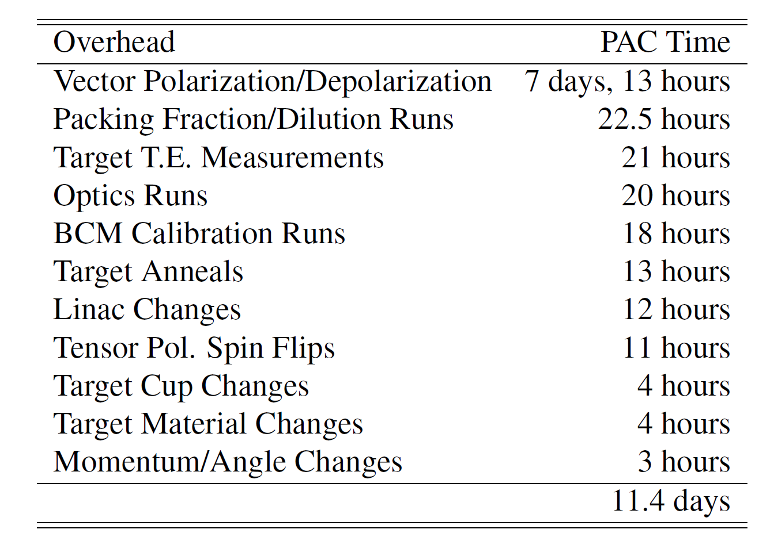
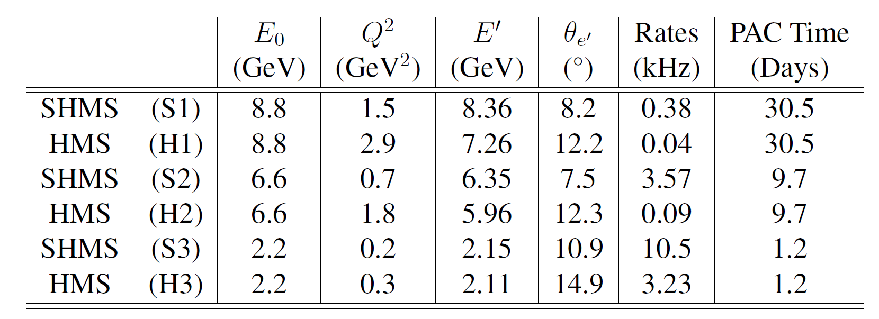
Kinematics & Overhead

Slide 9
Summary
  C1 Conditional Status recently removed
  New development of tensor-state flipping ~few times/hour while maintaining +/- vector polarization greatly suppresses drift systematics
  Beam Request: 41.4 Days Physics + 11.4 Days Overhead = 52.8 PAC Days Total

Slide 11
Back-Up

Slide 13
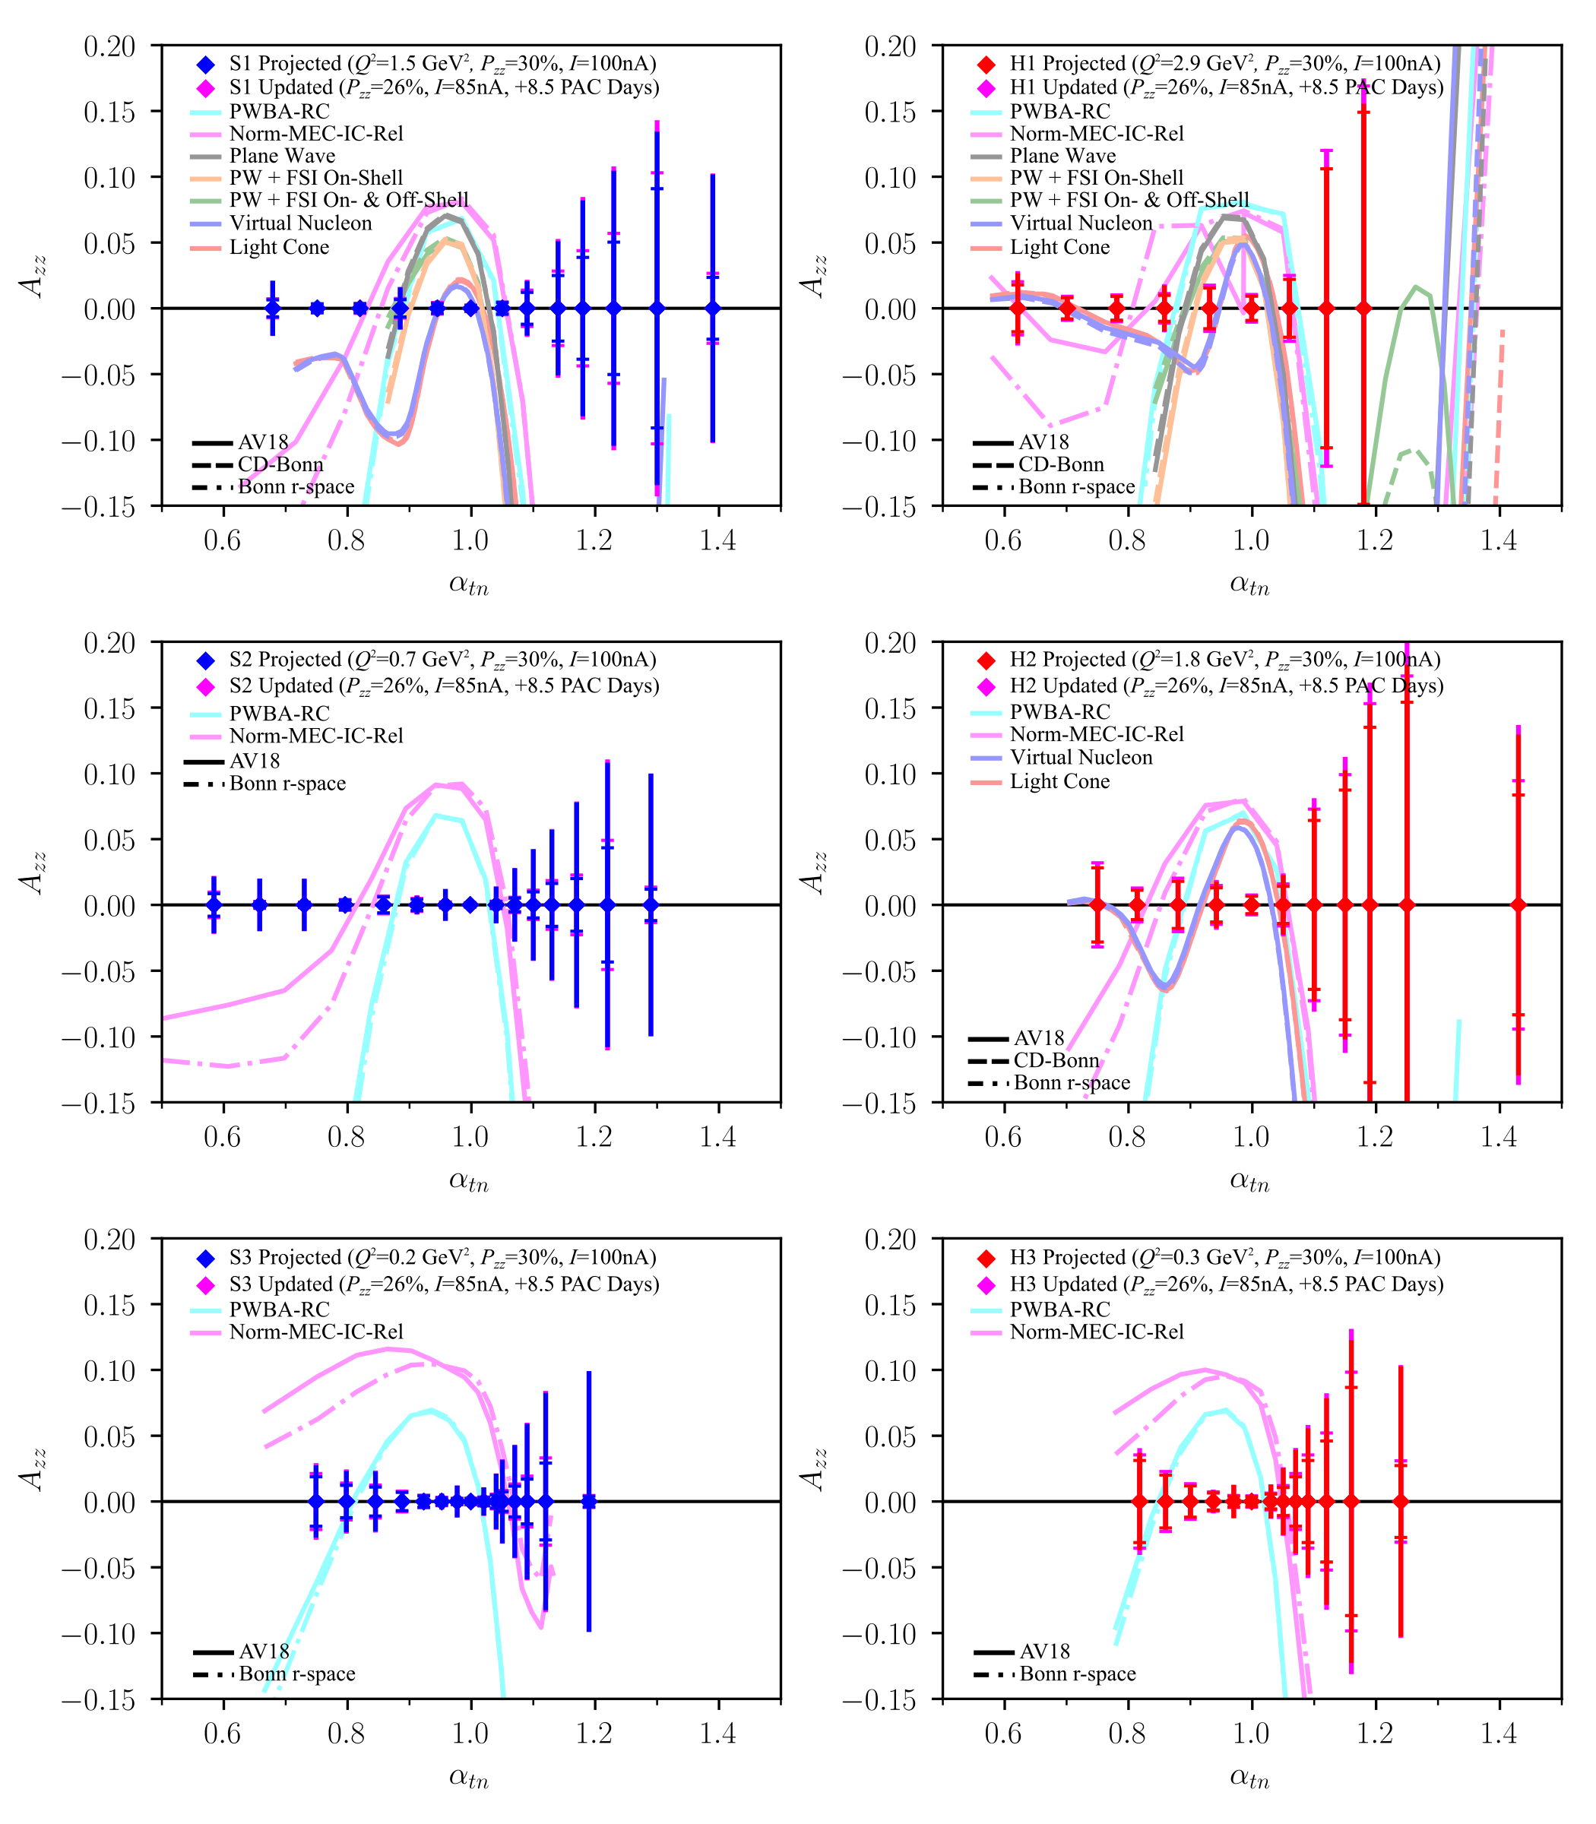

Slide 14
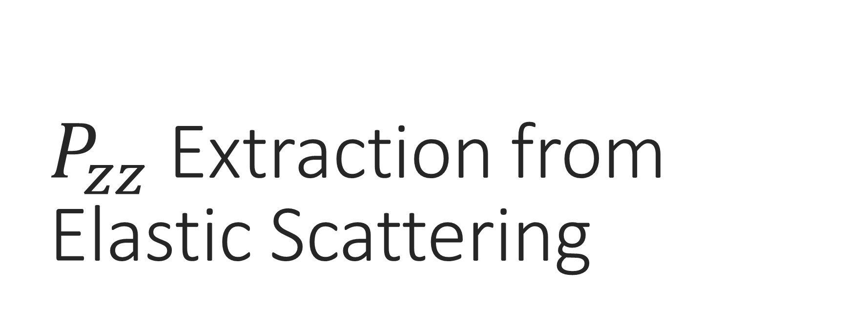
$P_{zz}$ Extraction from Elastic Scattering

Slide 15
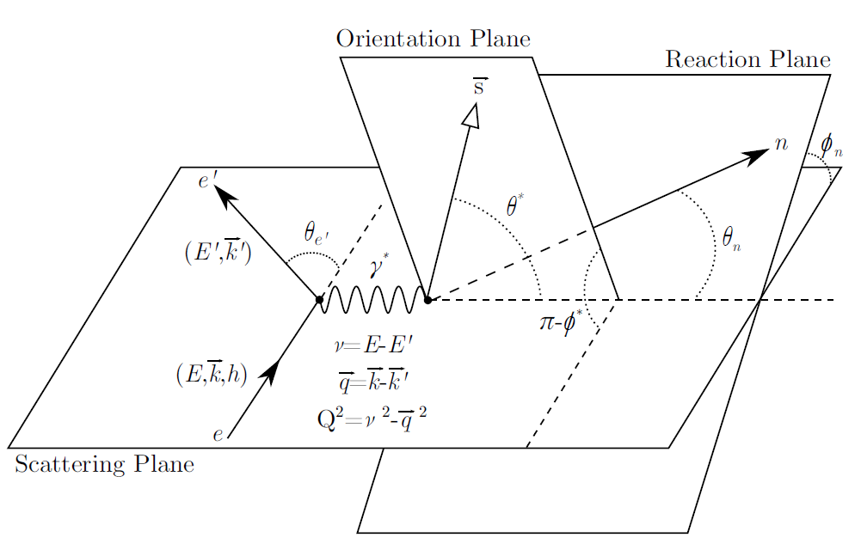
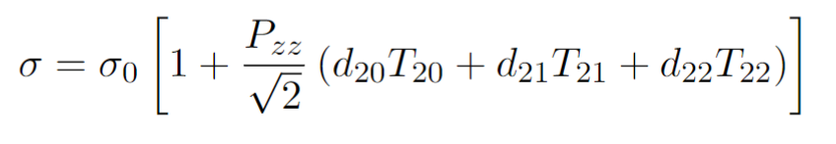
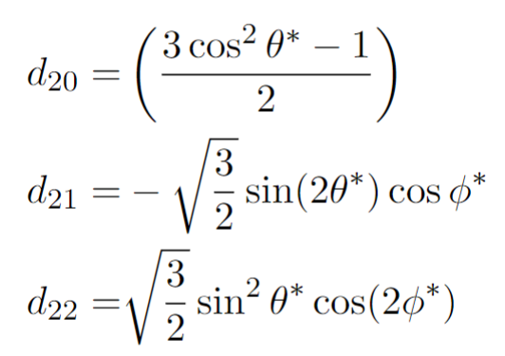
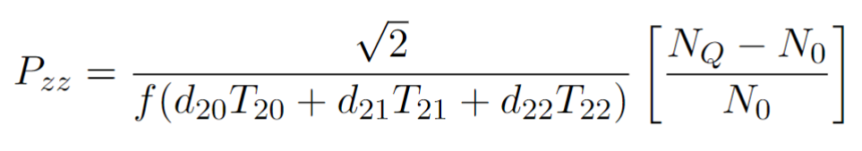

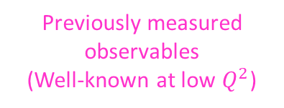
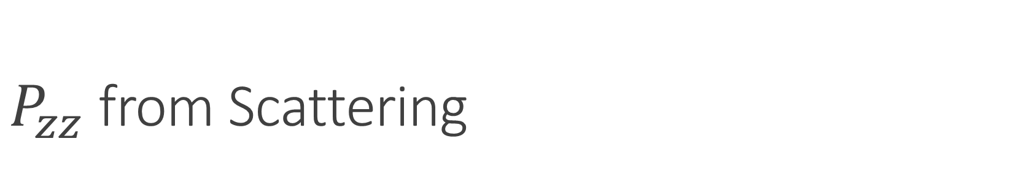
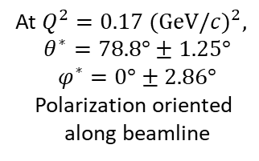

$P_{zz}$ from Scattering
The elastic cross-section can be used to extract the tensor polarization independently from NMR extraction
# Events w/ $P_{zz}>0$
Dilution factor
# Events w/ $P_{zz}=0$
At $Q^{2}=0.17 {(GeV/c)}^{2},$
$$θ^{∗}=78.8°±1.25°$$
$$φ^{∗}=0°±2.86°$$
Polarization oriented
along beamline
Previously measured observables
(Well-known at low $Q^{2}$)

Slide 16
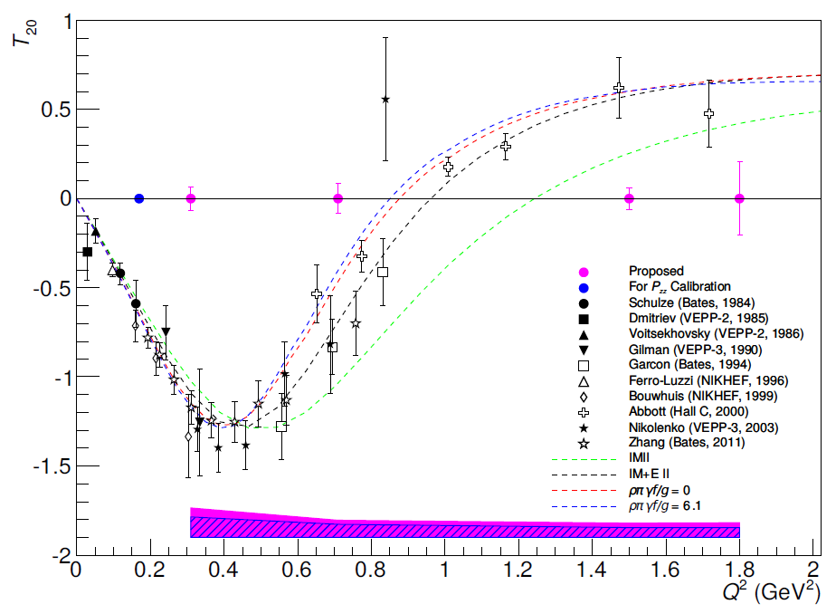
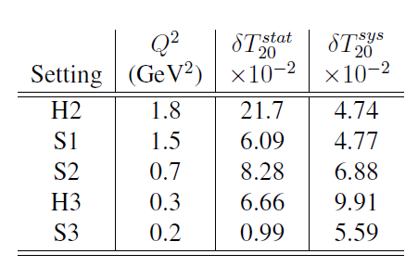
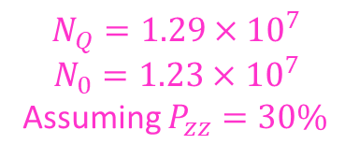

$P_{zz}$ from Scattering
$$N_{Q}=1.29×{10}^{7}$$
$$N_{0}=1.23×{10}^{7}$$
Assuming $P_{zz}=30\%$

Slide 17
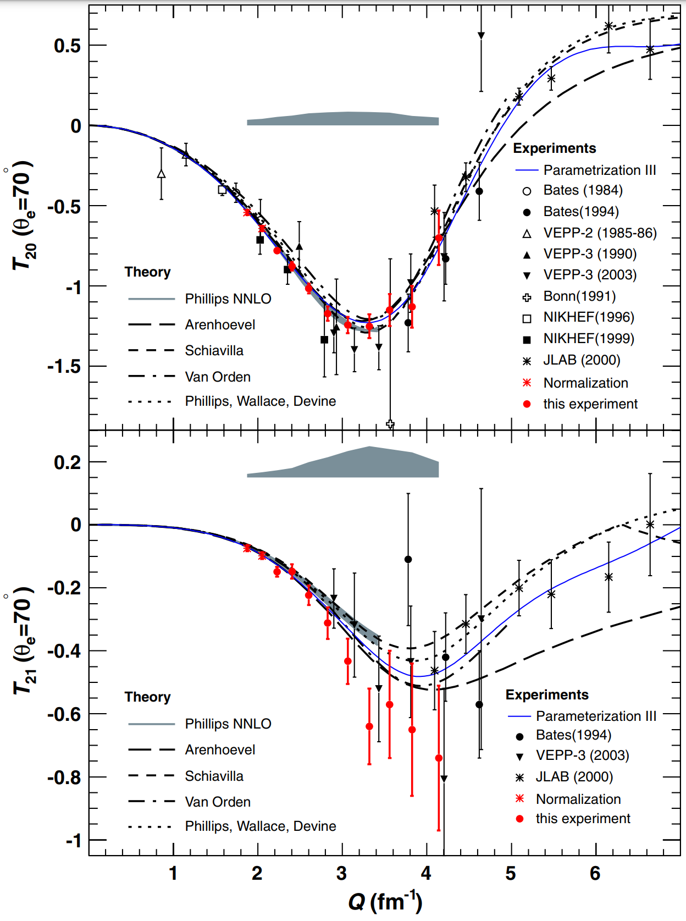
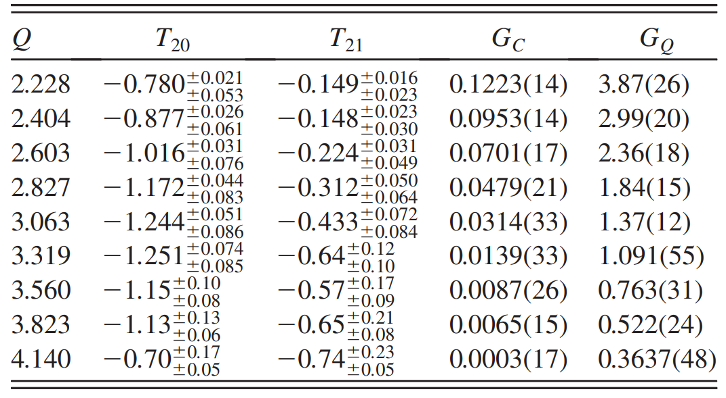
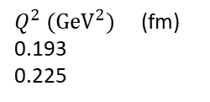

$P_{zz}$ from Scattering
At $Q^{2}=0.17 {GeV}^{2}$,
$Q=\frac{\sqrt{0.17 {GeV}^{2}}}{0.197 GeV∙fm}=2.09 {fm}^{−1}$
  $T_{20}=−0.78±0.06$ (7.7%)
    Can shrink to ~5% w/ parameterization as in Zhang, et al.
$Q^{2} ({GeV}^{2})$ (fm)
0.193
0.225
C Zhang, et al, PRL 107 252501 (2011)

Slide 18

$P_{zz}$ from Scattering
At $Q^{2}=0.17 {GeV}^{2}$,
$Q=\frac{\sqrt{0.17 {GeV}^{2}}}{0.197 GeV∙fm}=2.09 {fm}^{−1}$
  $T_{21}=−0.15±0.03$ (20%)
    Can shrink to ~5% w/ parameterization as in Zhang, et al.
$Q^{2} ({GeV}^{2})$ (fm)
0.193
0.225
C Zhang, et al, PRL 107 252501 (2011)

Slide 19
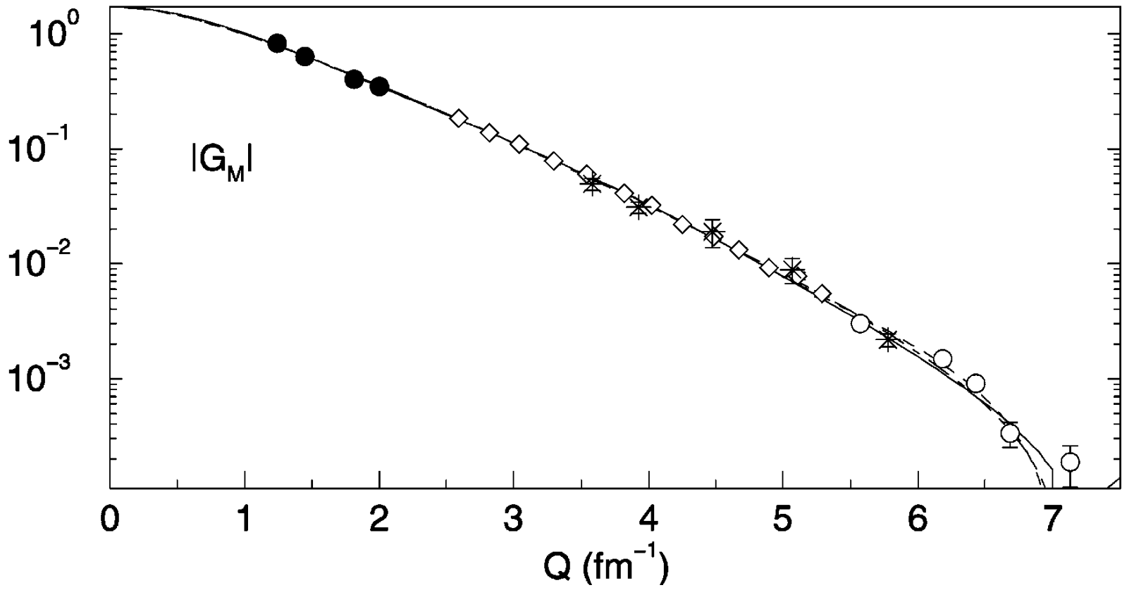
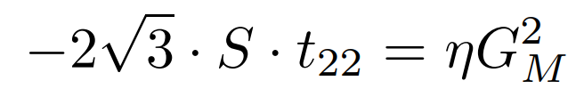
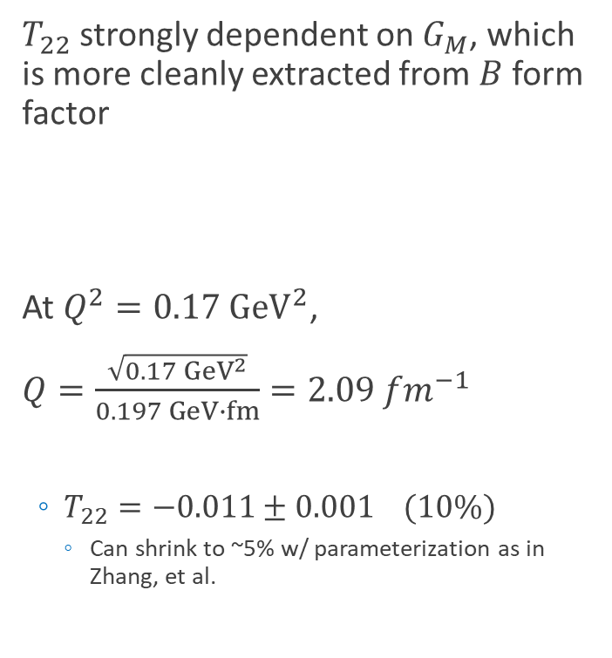
$P_{zz}$ from Scattering
$T_{22}$ strongly dependent on $G_{M}$, which is more cleanly extracted from $B$ form factor
At $Q^{2}=0.17 {GeV}^{2}$,
$Q=\frac{\sqrt{0.17 {GeV}^{2}}}{0.197 GeV∙fm}=2.09 {fm}^{−1}$
  $T_{22}=−0.011±0.001$ (10%)
    Can shrink to ~5% w/ parameterization as in Zhang, et al.
D Abbot, et al, Eur. Phys. J. A 7 421 (2000)

Slide 20
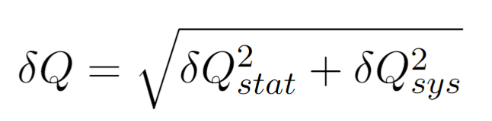
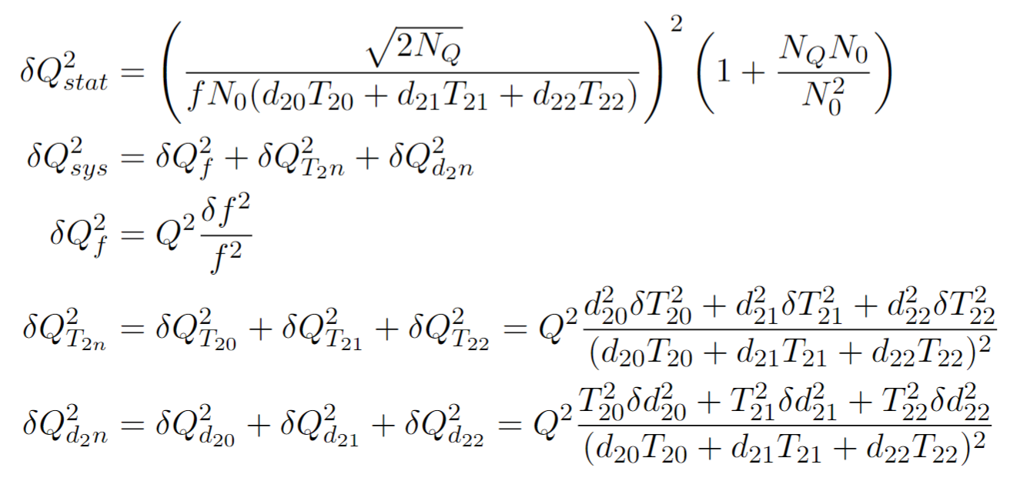


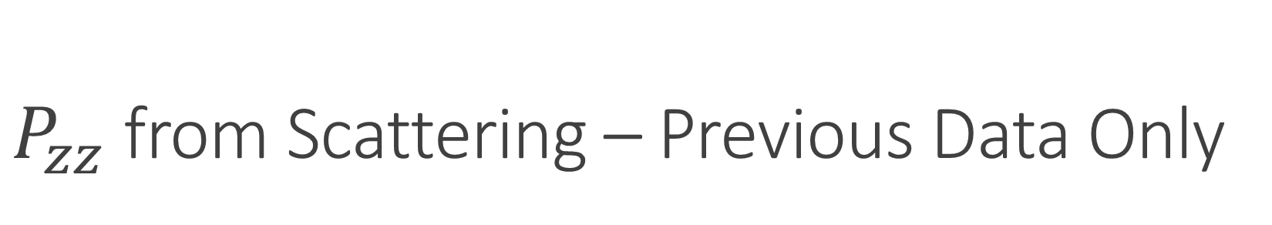
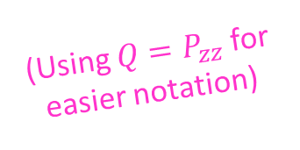
$P_{zz}$ from Scattering – Previous Data Only
Using values mentioned & $P_{zz}=30\%$,
the relative $P_{zz}$uncertainty from elastic scattering is 12.68%
  Similar rel. uncertainty in range $1\%<P_{zz}<100\%$
(Using $Q=P_{zz}$ for easier notation)
2.5%
1.05% 12.64%
10.13% 5.36% 0.45%
3.73% 2.82% 0.04%

Slide 21

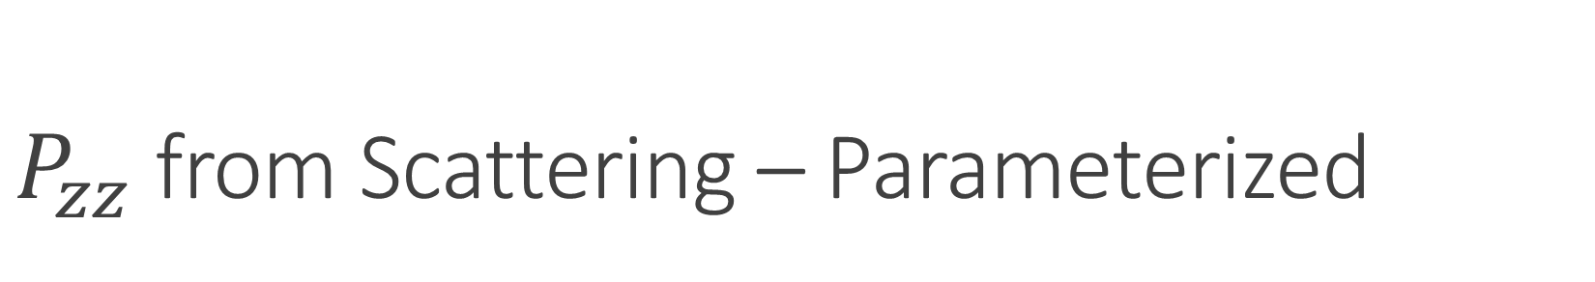
$P_{zz}$ from Scattering – Parameterized
Using values mentioned & $P_{zz}=30\%$,
the relative $P_{zz}$uncertainty from elastic scattering is 8.63%
  Similar rel. uncertainty in range $1\%<P_{zz}<100\%$
(Using $Q=P_{zz}$ for easier notation)
2.5%
1.05% 8.57%
6.59% 1.34% 0.25%
3.73% 2.82% 0.04%

Slide 22
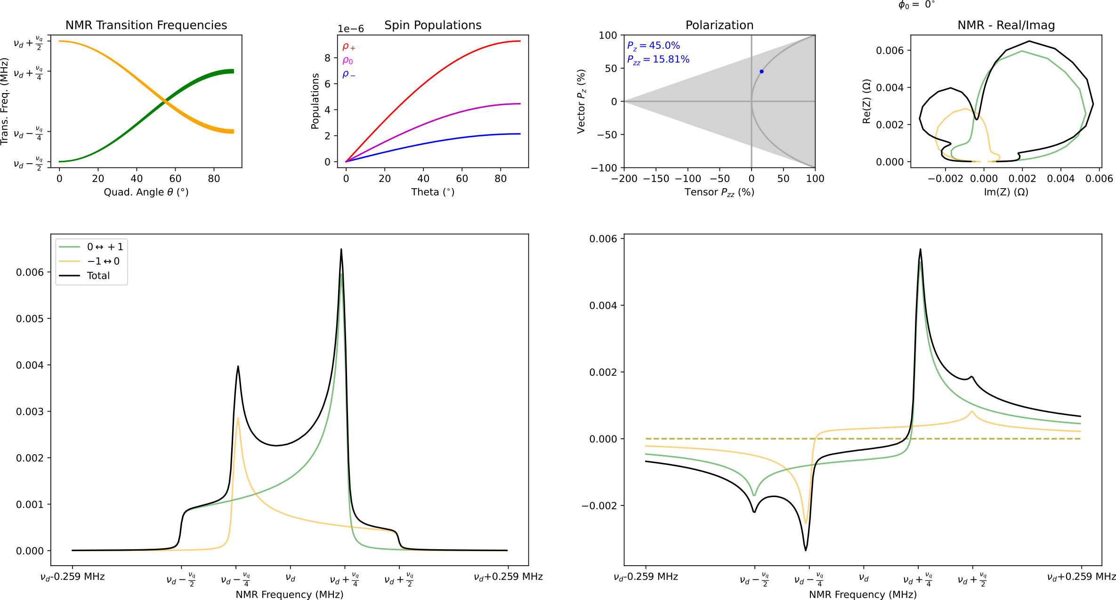
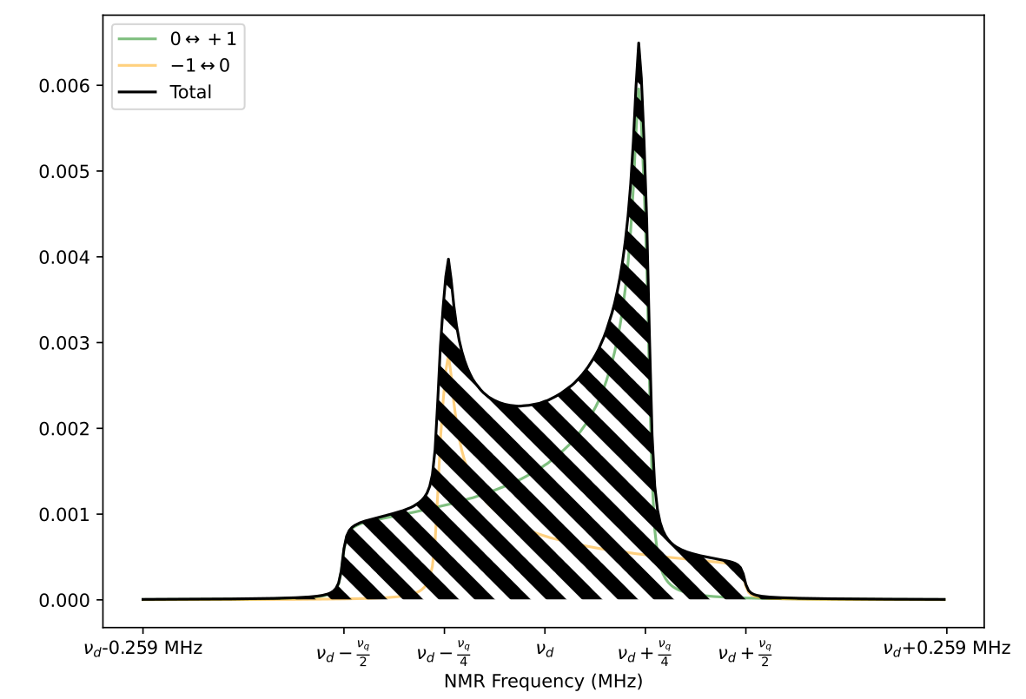
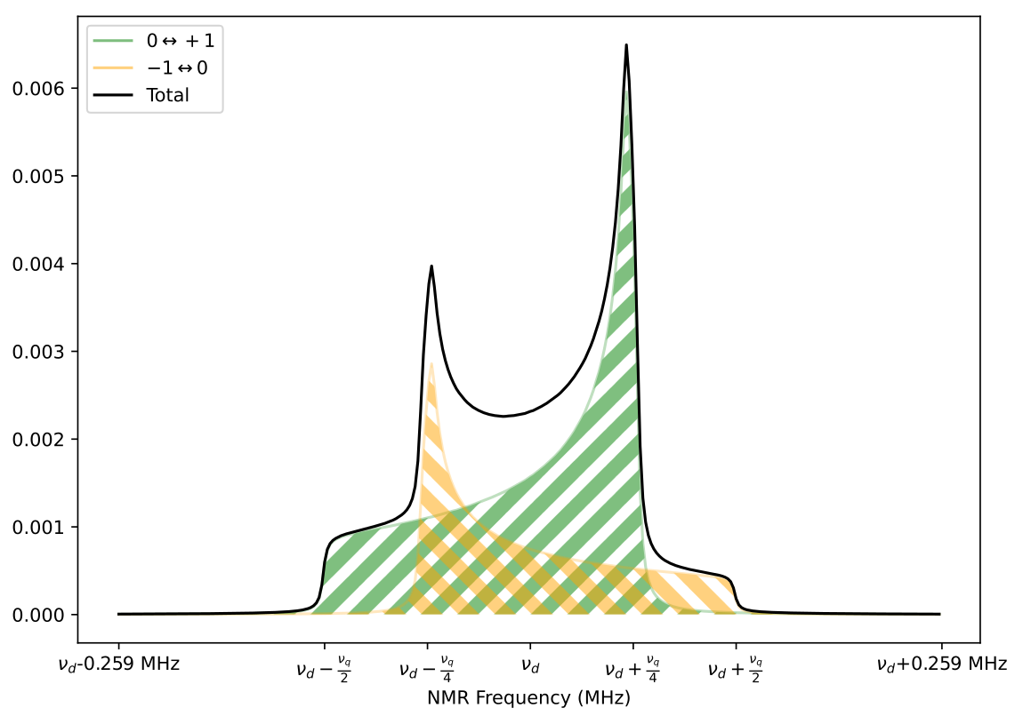




Measuring Polarization
For vector polarization,
$P_{z}=cc∙A_{NMR}=cc∙\left(I_{+}+I_{−}\right)$
For tensor polarization,
$P_{zz}=cc∙\left(I_{+}−I_{−}\right)$
Reducing $I_{−}$
Increases +$P_{zz}$
Line shape fits used to extract $I_{+}$ and $I_{−}$ area difference
D. Keller, et al., NIM A 981, 164504 (2020)
D. Keller, Eur. Phys. J. A 53, 155 (2017)

Slide 23
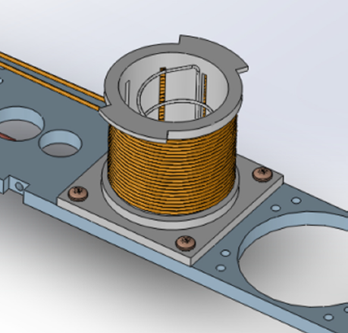
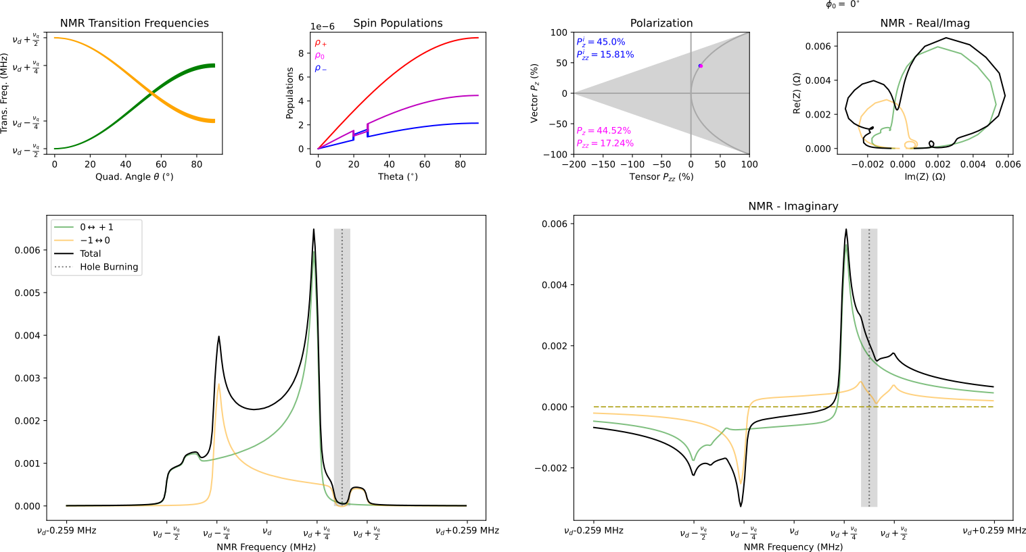
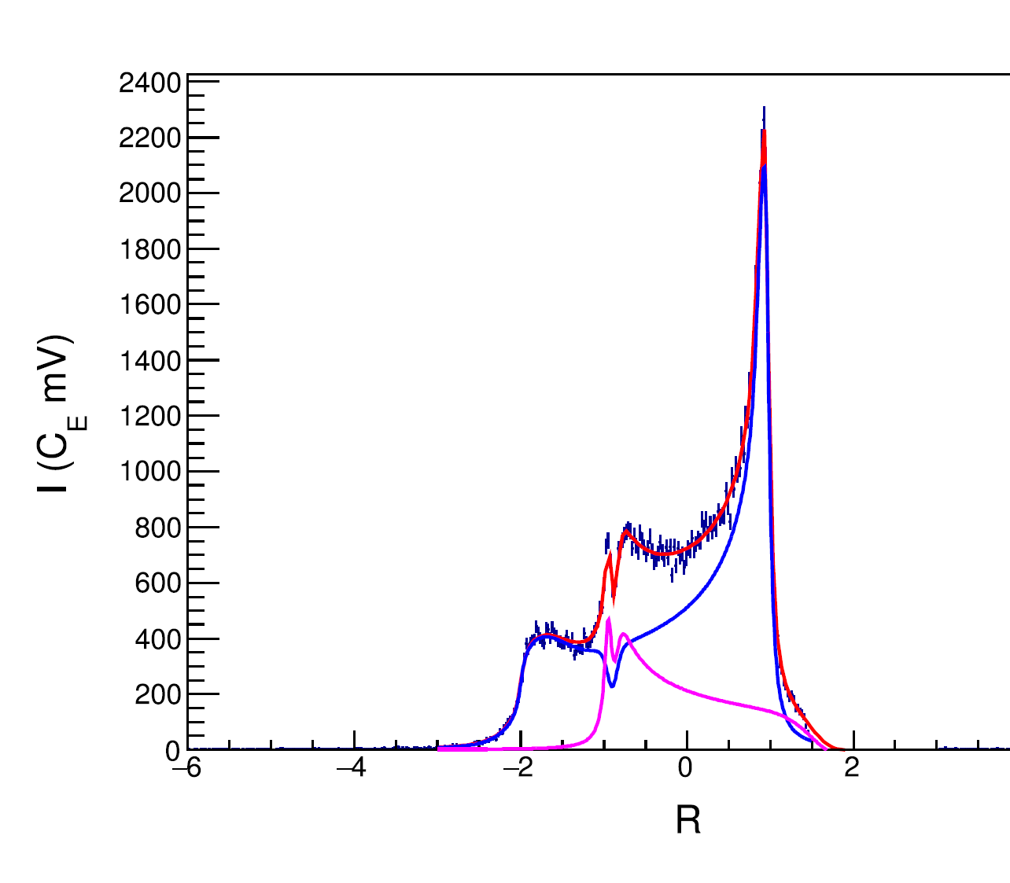
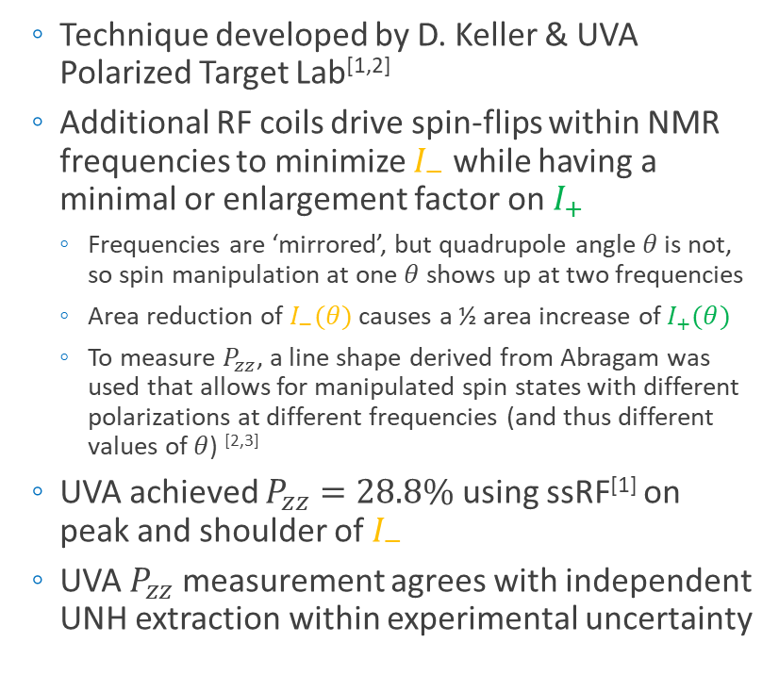



Semi-Selective RF Saturation (ssRF)
^{[1]} D. Keller, et al., NIM A 981, 164504 (2020)
^{[2]} D. Keller, Eur. Phys. J. A 53, 155 (2017)
^{[3]} A. Abragam, Principles of Nuclear Magnetism (1961)
  Technique developed by D. Keller & UVA Polarized Target Lab^{[1,2]}
  Additional RF coils drive spin-flips within NMR frequencies to minimize $I_{−}$ while having a minimal or enlargement factor on $I_{+}$
    Frequencies are ‘mirrored’, but quadrupole angle $θ$ is not, so spin manipulation at one $θ$ shows up at two frequencies
    Area reduction of $I_{−}(θ)$ causes a ½ area increase of $I_{+}(θ)$
    To measure $P_{zz}$, a line shape derived from Abragam was used that allows for manipulated spin states with different polarizations at different frequencies (and thus different values of $θ$) ^{[2,3]}
  UVA achieved $P_{zz}=28.8\%$ using ssRF^{[1]} on peak and shoulder of $I_{−}$
  UVA $P_{zz}$ measurement agrees with independent UNH extraction within experimental uncertainty
$$P_{zz}=28.8\%±5.7\% {(rel)}^{[1]}$$
$$+\frac{1}{2}I(θ)$$
$$−I(θ)$$

Slide 24





ssRF + Rotation
^{[1]} D. Keller, et al., NIM A 981, 164504 (2020)
^{[2]} D. Keller, Eur. Phys. J. A 53, 155 (2017)
  Technique developed by D. Keller & UVA Polarized Target Lab^{[1,2]}
  Rotating target material changes which nuclei are at which $θ$, and thus which NMR frequency
  Rotating during ssRF can better transport spin manipulation, further increasing tensor polarization
    Ideal rotation would be about $θ_{MAS}=54.7°$
  UVA achieved $P_{zz}>36\%$ using double ssRF + rotation^{[1]}
$$P_{zz}=36.3\%±9.3\% {(rel)}^{[1]}$$
ssRF
Rot.
ssRF
Rot.

Slide 25



UNH NMR Cross-Check
M.H. Cohen, F. Reif, Solid State Phys. 5, 321 (1957)
  UNH simulation based on modified Cohen & Reif
  Calculates transition frequencies from energy levels
    $E_{m}/h=−mν_{D}+\frac{1}{2}ν_{q}f_{0}^{H}\left(m^{2}−\frac{I(I+1)}{3}\right)$
      $f_{0}^{H}=\frac{3}{2}\cos^{2}{θ}−\frac{1}{2}−\frac{1}{2}η\sin^{2}{θ}\cos{(2φ)}$
      $I=1$ and $m=−1, 0, +1$
  Assumes random powder pattern for $θ$ &
  counts spin flips across NMR frequency bins
    Calculates ~125,000 spin flips into ~300 NMR bins
    Spin flips determined by $P_{z}$ and $P_{zz}$, which can be independent in $θ \& φ$ bins to account for simple RF manipulation
    Broadens each frequency bin into all others via real & imaginary Lorentzian
      Allows phase angle extraction
  Higher order spin diffusion not yet fully implemented
    Simulation already agrees with UVA direct $P_{zz}$ measurement within experimental uncertainties, and we expect this agreement to further improve once spin diffusion is fully implemented
Preliminary

Slide 26
Measurement
Helicity States

Slide 27







Tensor Observables
In the polarized deuteron cross section, there are four asymmetry terms
  $h_{e}= \text{Electron} helicity$
  $P=P_{z}=$ Vector polarization
  $Q=P_{zz}=$Tensor polarization
  Integrating electron helicity suppresses $A_{||}$ and $A_{T}^{ed}$
  Switching between positive and negative vector polarizations and integrating suppresses $A_{V}^{d}$
$$×$$
$$×$$
$$×$$
$$0$$
$$0$$
W. Leidemann, E.L. Tomusiak, H. Arenhovel, Phys. Rev. C 43, 1022 (1991)

Slide 28









Playing with Helicity States
For unpolarized beam $\left(h_{e}=0\right):$
2 Helicity States – Has diluting asymmetry
  $σ_{Q}=σ\left(P,Q\right)$
  $σ_{0}=σ\left(0,0\right)$
4 Helicity States – Suppresses diluting asymmetry, giving cleaner measurement
  $$A_{zz}=\frac{2}{fQ}\left(\frac{N_{Q}−N_{0}}{N_{0}}\right)\left[1−fPA_{V}^{d}\left(\frac{N_{0}}{N_{Q}−N_{0}}\right)\right]$$
$$A_{zz}=\left(\frac{2}{fQ}\right)\left[\frac{\left(N_{1}+N_{2}\right)−\left(N_{3}+N_{4}\right)}{\left(N_{3}+N_{4}\right)}\right]=\left(\frac{2}{fQ}\right)\left[\frac{N_{Q}−N_{0}}{N_{0}}\right]$$
$$σ_{Q}$$
$$σ_{0}$$
Drift systematics also greatly suppressed w/ this method, nearly eliminating the leading systematic uncertainties for $b_{1}$

Slide 29




Tensor Observables
Beam is polarized, leading to 8 helicity states
  Combining these in various ways can give us 4 unique asymmetries
  4 measurements & 4 unknowns
    Simultaneously measure all pol. deuteron asymmetries from the upcoming tensor experiments
Beam Asym w/ Tensor Target:
Beam/Target Vector Asym:
Target Vector Asym:

Slide 30


Helicity States – Definitions
Luminosities w/o charge & eff.
# Events Detected
Acceptance
Beam Charge
Efficiencies

Slide 31


Helicity States – 4 States
$$σ_{Q}$$
$$σ_{0}$$

Slide 32

Helicity States – 4 States
$$σ_{Q}$$
$$σ_{0}$$
$$≈\frac{2}{fQ}\left(\frac{σ_{Q}−σ_{0}}{σ_{0}}\right)$$

Slide 33




Helicity States – 4 States
$$σ_{Q}$$
$$σ_{0}$$
With fast tensor pol. switching, $ε_{1}q_{1}=ε_{3}q_{3}$ & $ε_{2}q_{2}=ε_{4}q_{4}$
$$P_{1}=P_{3}=P$$
$$P_{2}=P_{4}=−P$$
$$=\frac{2}{fQ}\left(\frac{σ_{Q}−σ_{0}}{σ_{0}}\right)$$

Slide 34

Helicity States
In the case where integrated beam helicity is 0, this gives

Slide 35







Helicity States
In the case where integrated beam helicity is 0, this gives
$$+P$$
$$−P$$
$$+P$$
$$−P$$
Suppressed by dilution factor, $|P|$, and by difference of $∆εq$
In worst case scenario $<0.7∙0.3∙0.004≈0.0008≈0.08\%$ relative to $A_{zz}$
$≈$ Transversity $∆εq$ used as $∆(∆εq)$
to be over-estimate

Slide 36





Helicity States
More complicated if $h_{e}≠0$, but other terms still suppressed
Suppressed similar to $A_{V}^{d}$ w/ further $h_{e}$ suppression
Overestimate:
$$h_{e}≪1×{10}^{−4}$$
Suppressed by $h_{e}$
$\frac{f}{2}\left(Fraction\right)≈1/A_{zz}^{′}$, so term goes as
$$A_{zz}=\left(\frac{2}{f}\right)A_{zz}^{′}\left[1+\left(≈0\right)−2h_{e}\frac{A_{T}^{ed}}{A_{zz}^{′}}\right]$$
Likely not an issue as it’s expected that $A_{T}^{ed}≲A_{zz}$

Slide 37





Helicity States
Though suppressed, by tagging beam helicity we can simultaneously measure all diluting asymmetries alongside $A_{zz}$ for no additional beamtime
  Tagging +/- beam helicities for each of the 4 polarization states gives 8 total beam-target polarization states
  Direct measurements eliminate model-dependent uncertainties from $A_{T}^{ed}$, $A_{V}^{d}$, & $A_{||}$

