Slide 1
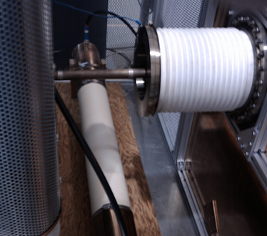
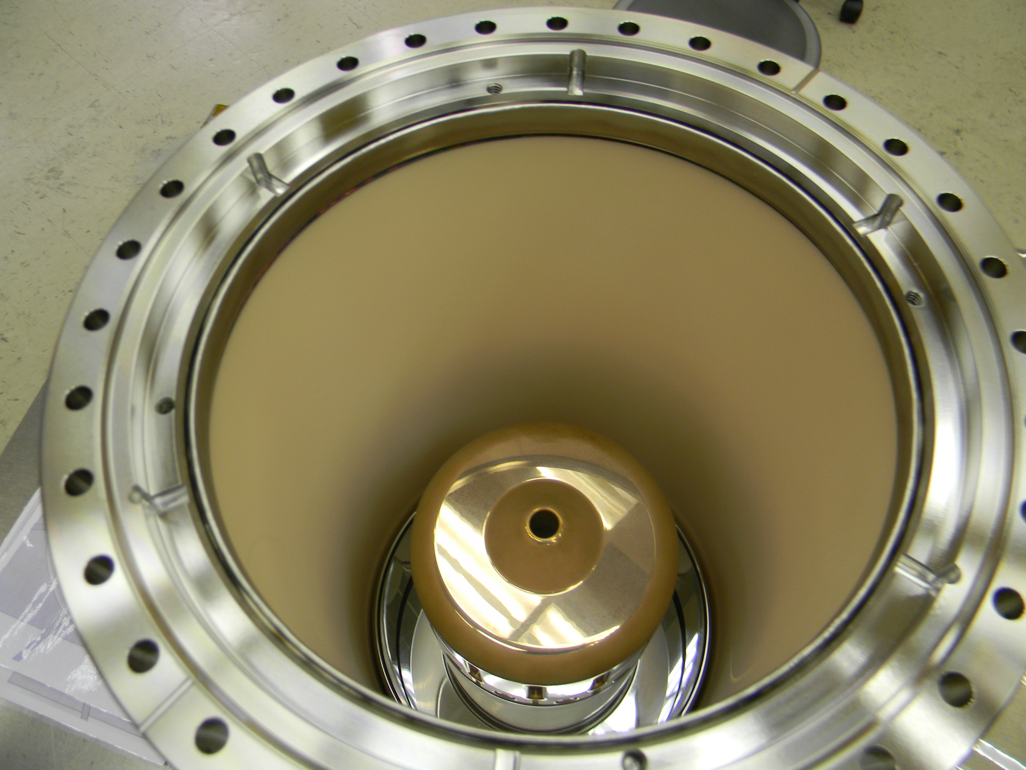
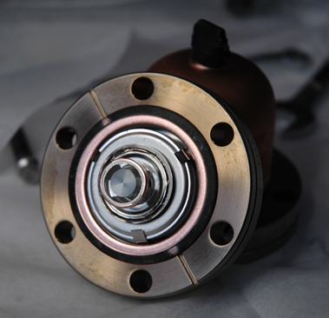
The TRIUMF ARIEL rf modulated electron source
EIC14, March 17-21,
Jefferson Lab, Newport News, VA, USA
F. Ames,
Y. Chao, K. Fong, S. Kocielniak, N. Khan, A. Laxdal, L. Merminga,
C. Sinclaire, D. Storey

Slide 2
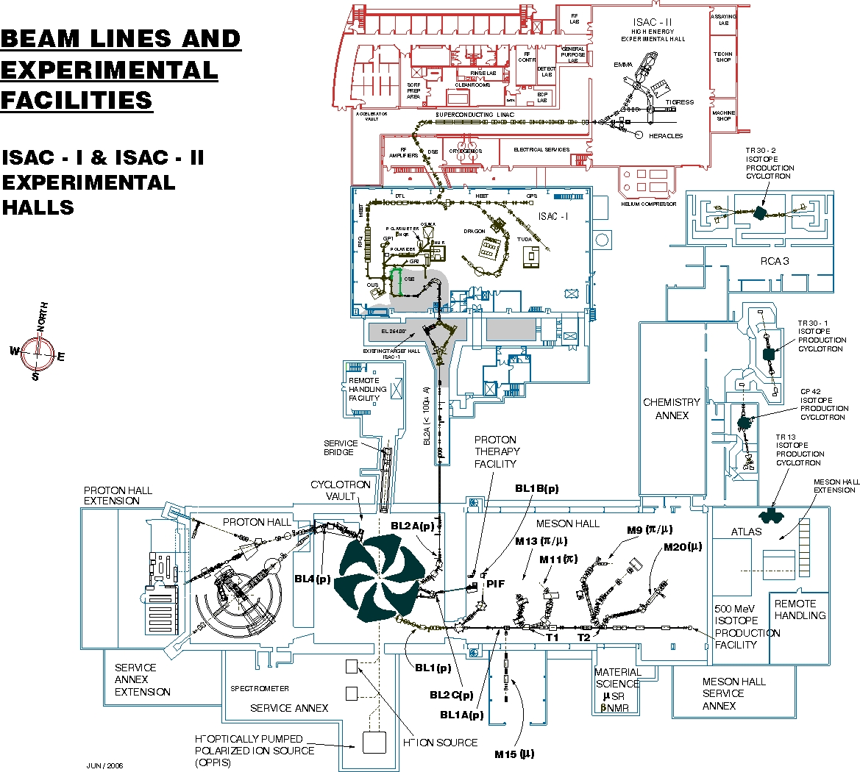
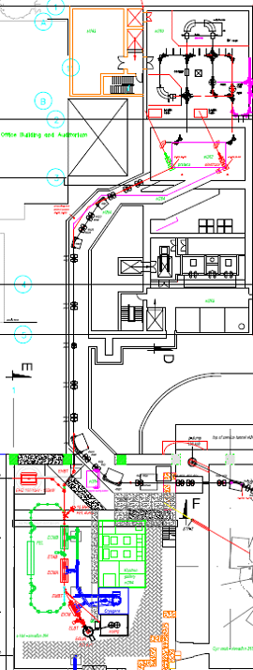
TRIUMF ARIEL
500 MeV H⁻ cyclotron
up to 400 µA into 4 beam lines,
meson and isotope production
ISAC: SOL facility for the production and acceleration of rare isotope beams (RIB)
Highest power driver beam (50 kW protons)
plus post-accelerator
Now adding ARIEL to increase from one to three simultaneous beams
Add e-Linac (50MeV 10mA cw - 1.3GHz SC linac) to produce rare isotopes via photofission
ISAC-II
40MV SC Linac
ISAC-I
ARIEL
e-Linac
500MeV Cyclotron

Slide 3
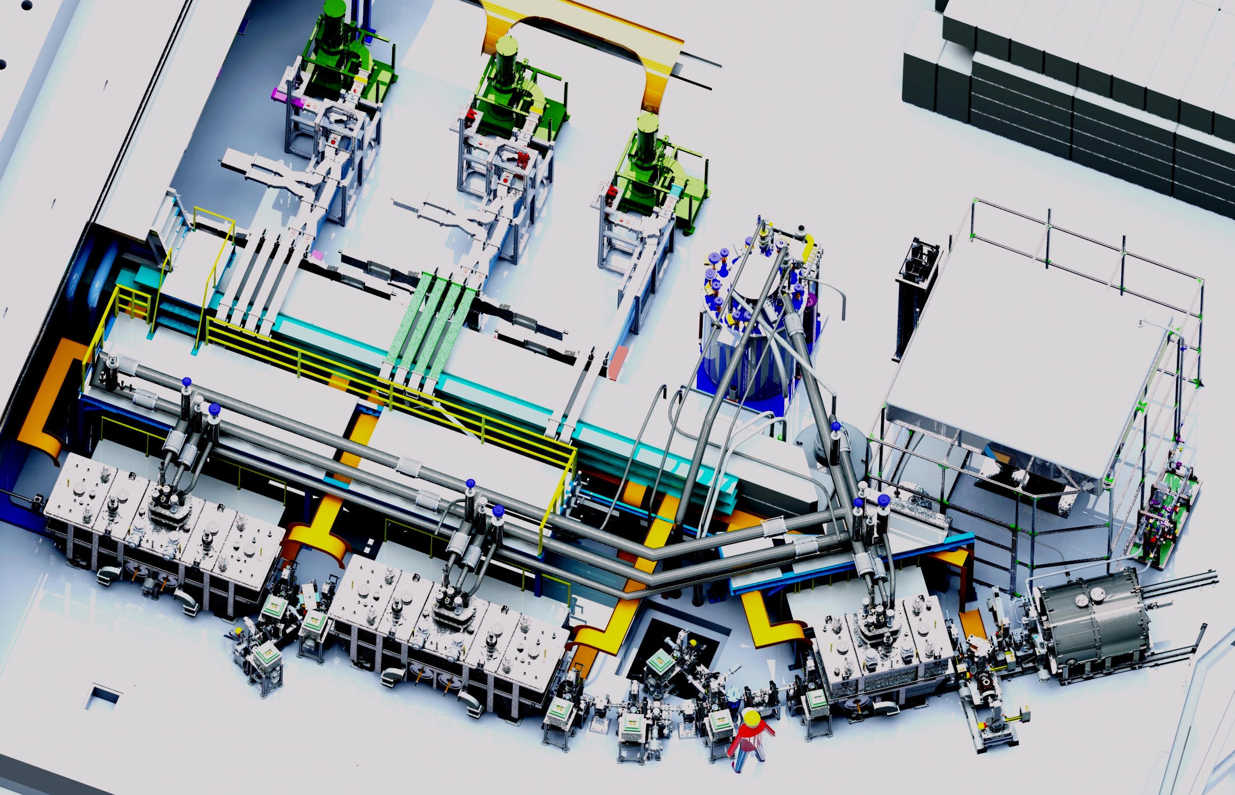
e-linac
5 9-cell superconducting
cavities
2K, 1.3 GHz
final energy 50 MeV
continuous beam 10 mA
injection at 300 keV
modulated at 650 MHz
Phase 1 (Sept. 2014)
ICM +ACM1 with 1 cavity
25 MeV
klystrons
300 kV supply
ACM2(50MeV)
e-gun(300keV)
ACM1(30MeV)
ICM(10MeV)

Slide 4
electron source specifications
rf modulation frequency 650 Mhz,
pulse length +/- 16º (137 ps).
average current 10 mA
charge / bunch 15.4 pC
kinetic energy 300 keV
normalized transverse emittance ~5 µm
duty factor for macro pulsing 0.1-100% (3 W-3 kW)
→ Gridded thermionic source

Slide 5
rf modulation concept
grid
anode
cathode
Triode was used for FELIX @ NIKHEF
R.J. Bakker et al., NIM A307 (1991) 543
≈
U_{b}+U_{rf}
=
U_{a}
I(t) = g₂₁ (U_{b}+U_{rf}cos(ωt) -U_{c})
g₂₁: transconductance
U_{c}: cut off voltage

Slide 6
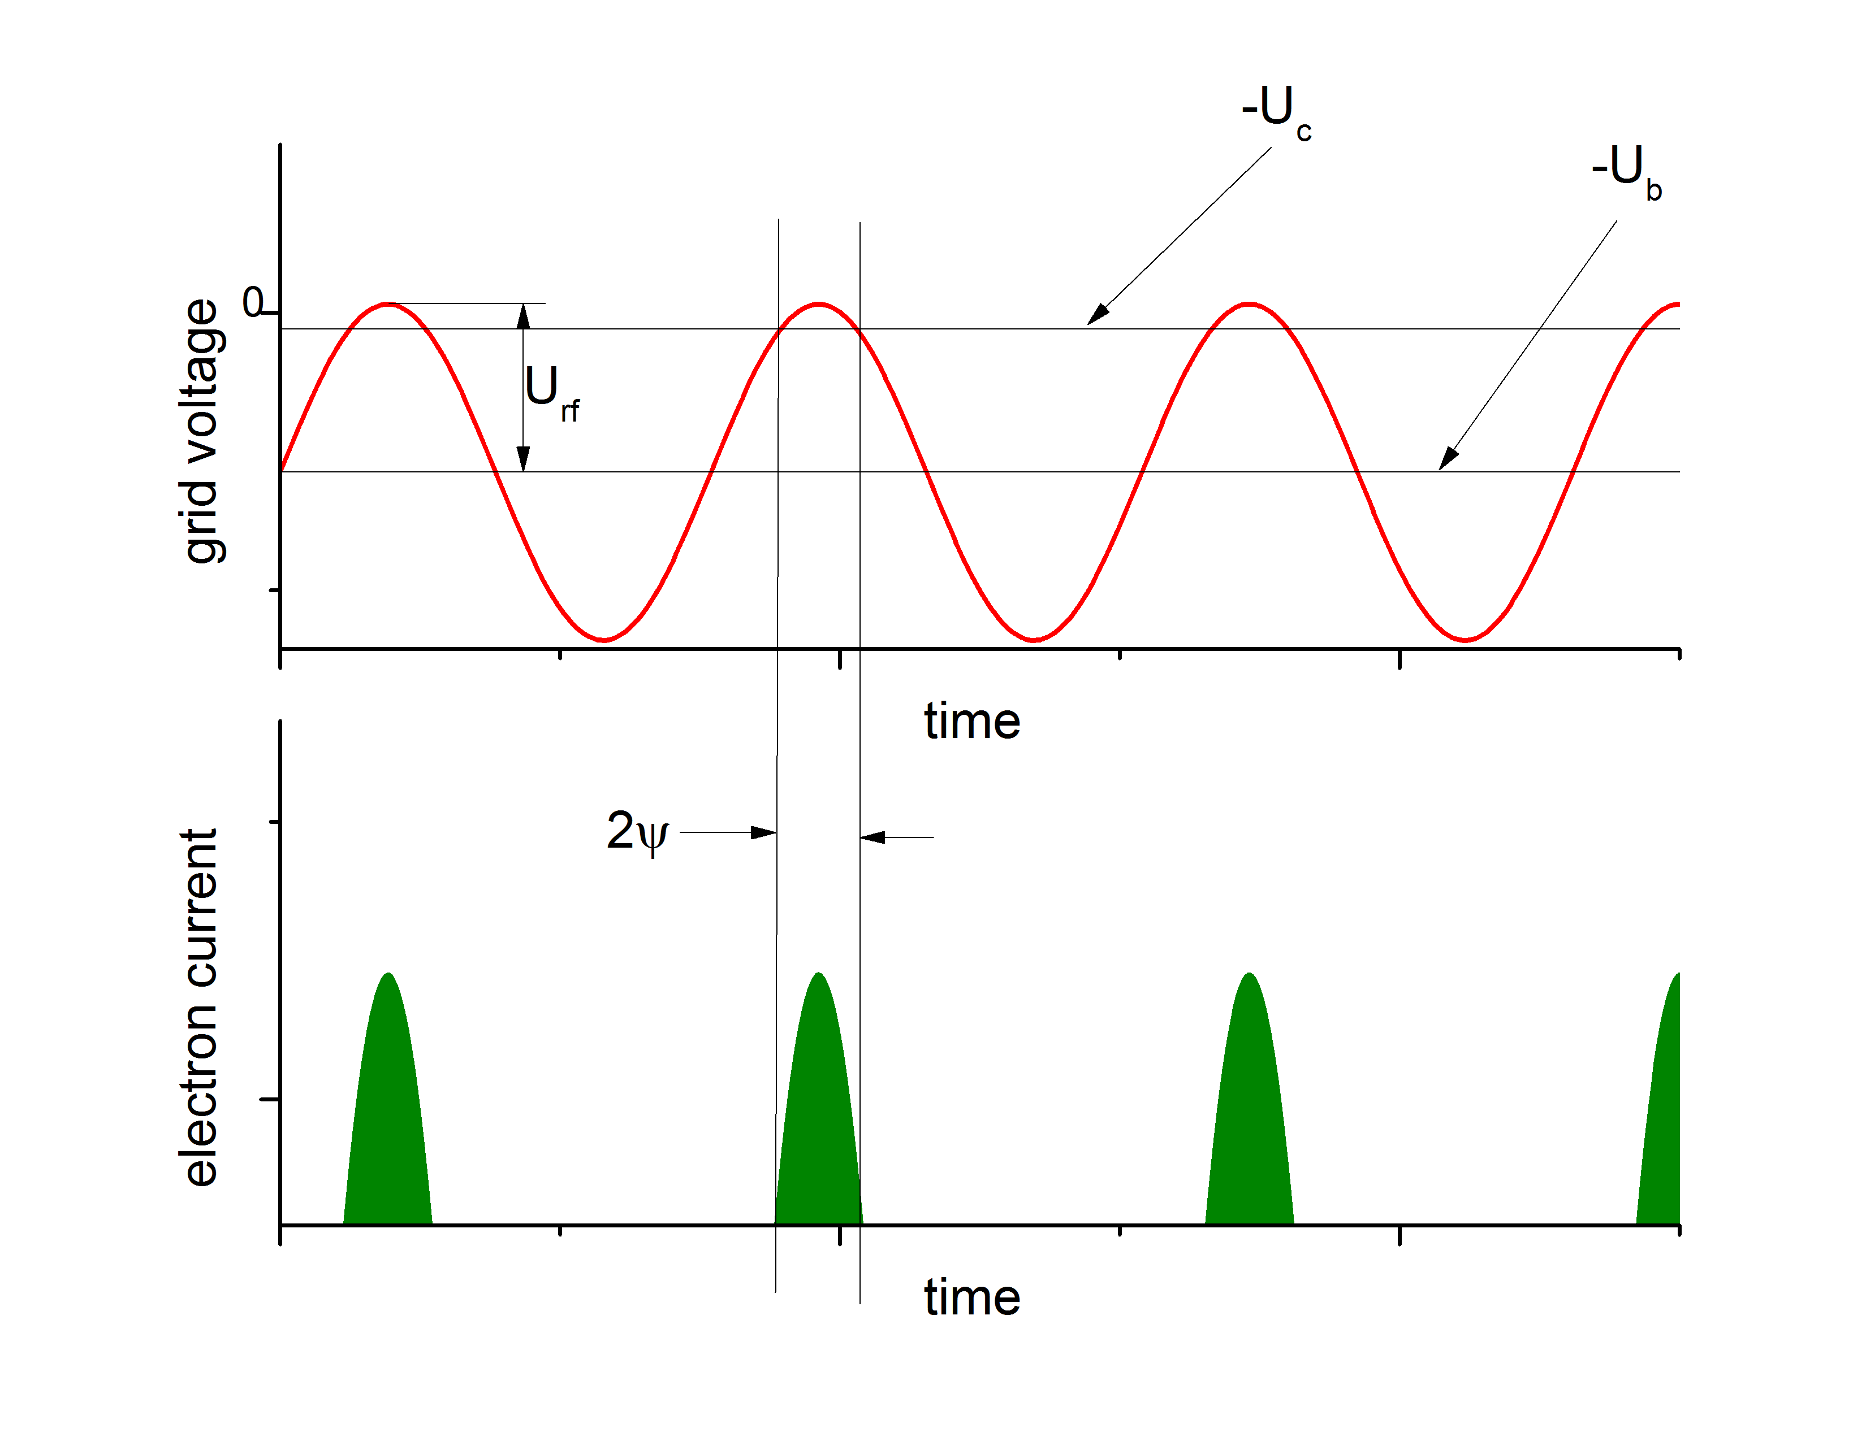
example
g₂₁ = 0.022 Ω⁻¹
U_{c} = -10 V
ψ = ± 16 º
Q = 15.4 pC
Ub = -201 V
U_{rf} = 198.5 V
I_{peak} =165 mA

Slide 7
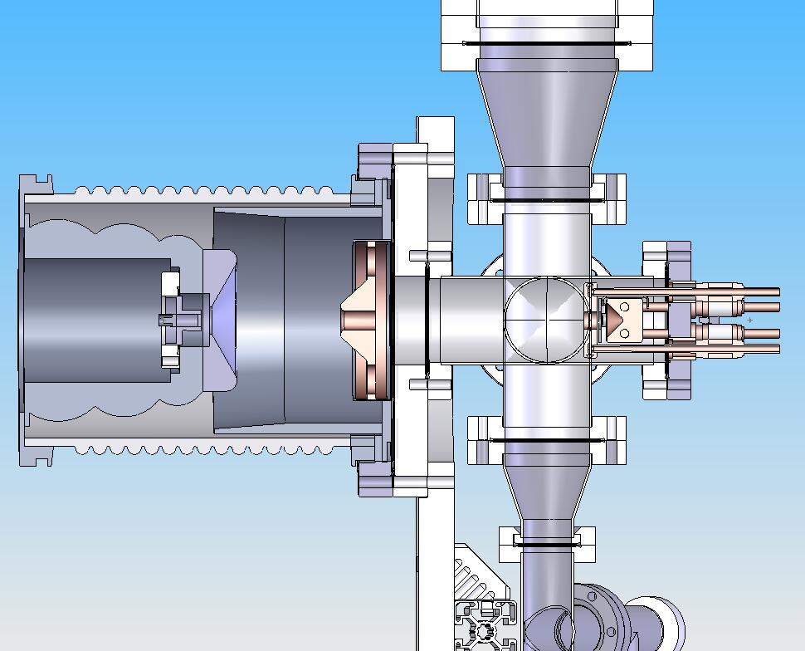
100 kV prototype
source body
and electrodes on loan
from Jefferson Lab
gridded cathode:
CPI Y-845
First test diagnostics
Faraday cup
Allison type
emittance scanner
10 cm
Faraday cup
beam stop
collimator
Ø 15 mm
cathode
place for
emittance meter
anode

Slide 8
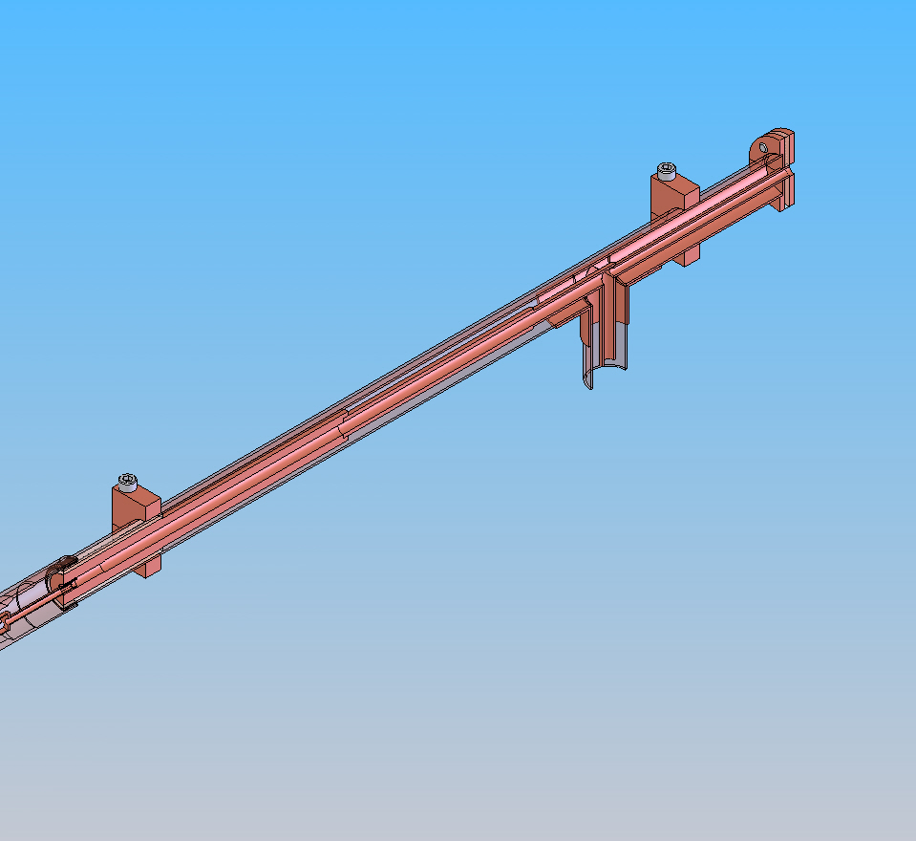
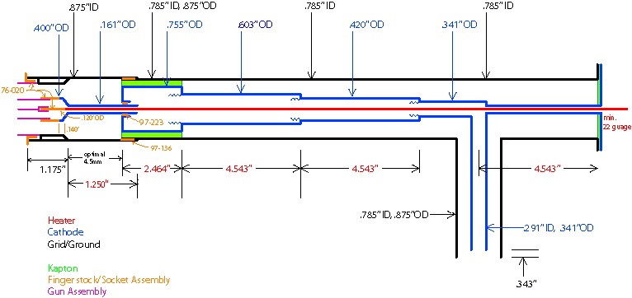
rf matching
impedance at cathode grid ≈ 2 kΩ
rf transformer as dc break between ground and high voltage

Slide 9
100 kV prototype measurements
low energy beam line for source testing
macro pulsing to reduce total beam power by modulating rf
SOL1
VS1A
VS1B
SOL2
SOL3
VS3
FC
MB0
source
rf buncher
rf defl
emit
SOL1
VS1
FC
Image of cathode grid

Slide 10
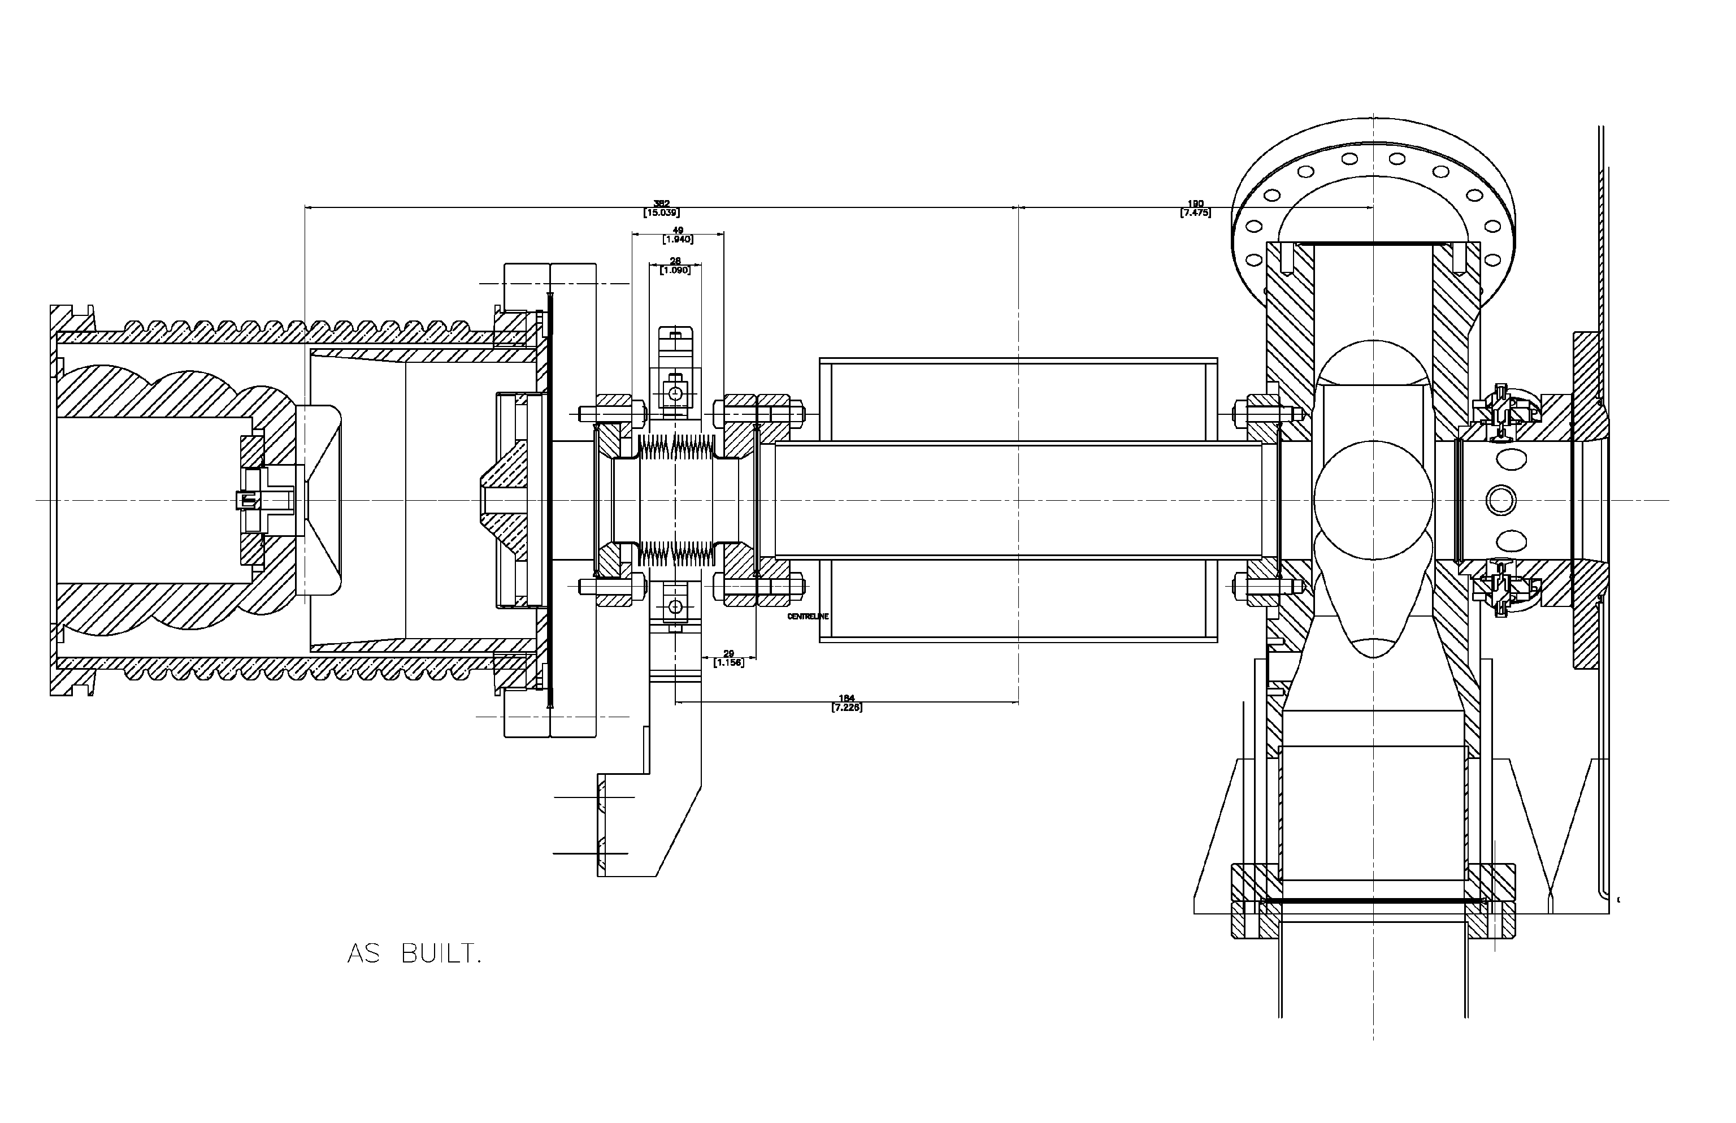
transversal emittance
VLBT
SOL1
Fit Point
Measured Point
scan solenoide
X Emittance (m-rad) | 9.28883×10⁻⁶
Y Emittance (m-rad) | 9.47943×10⁻⁶
10

Slide 11
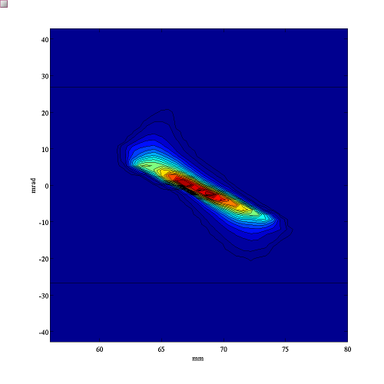
transversal emittance
Allison Emittance
scanner
Measurement
As function of
solenoid field
Laxdal et al.
BIW’12

Slide 12
longitudinal emittance

Slide 13
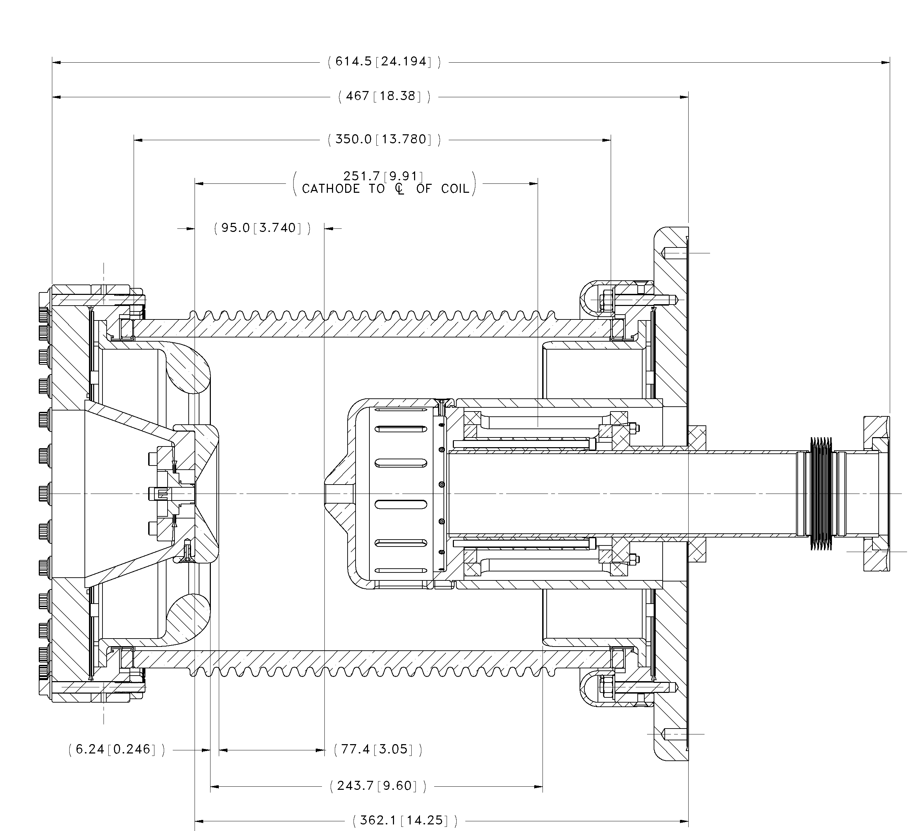
300 kV source design
ceramic insulator
titanium cathode electrodes
copper beryllium anode
reduced surface at
negative potential
steerer magnets
cathode
anode

Slide 14
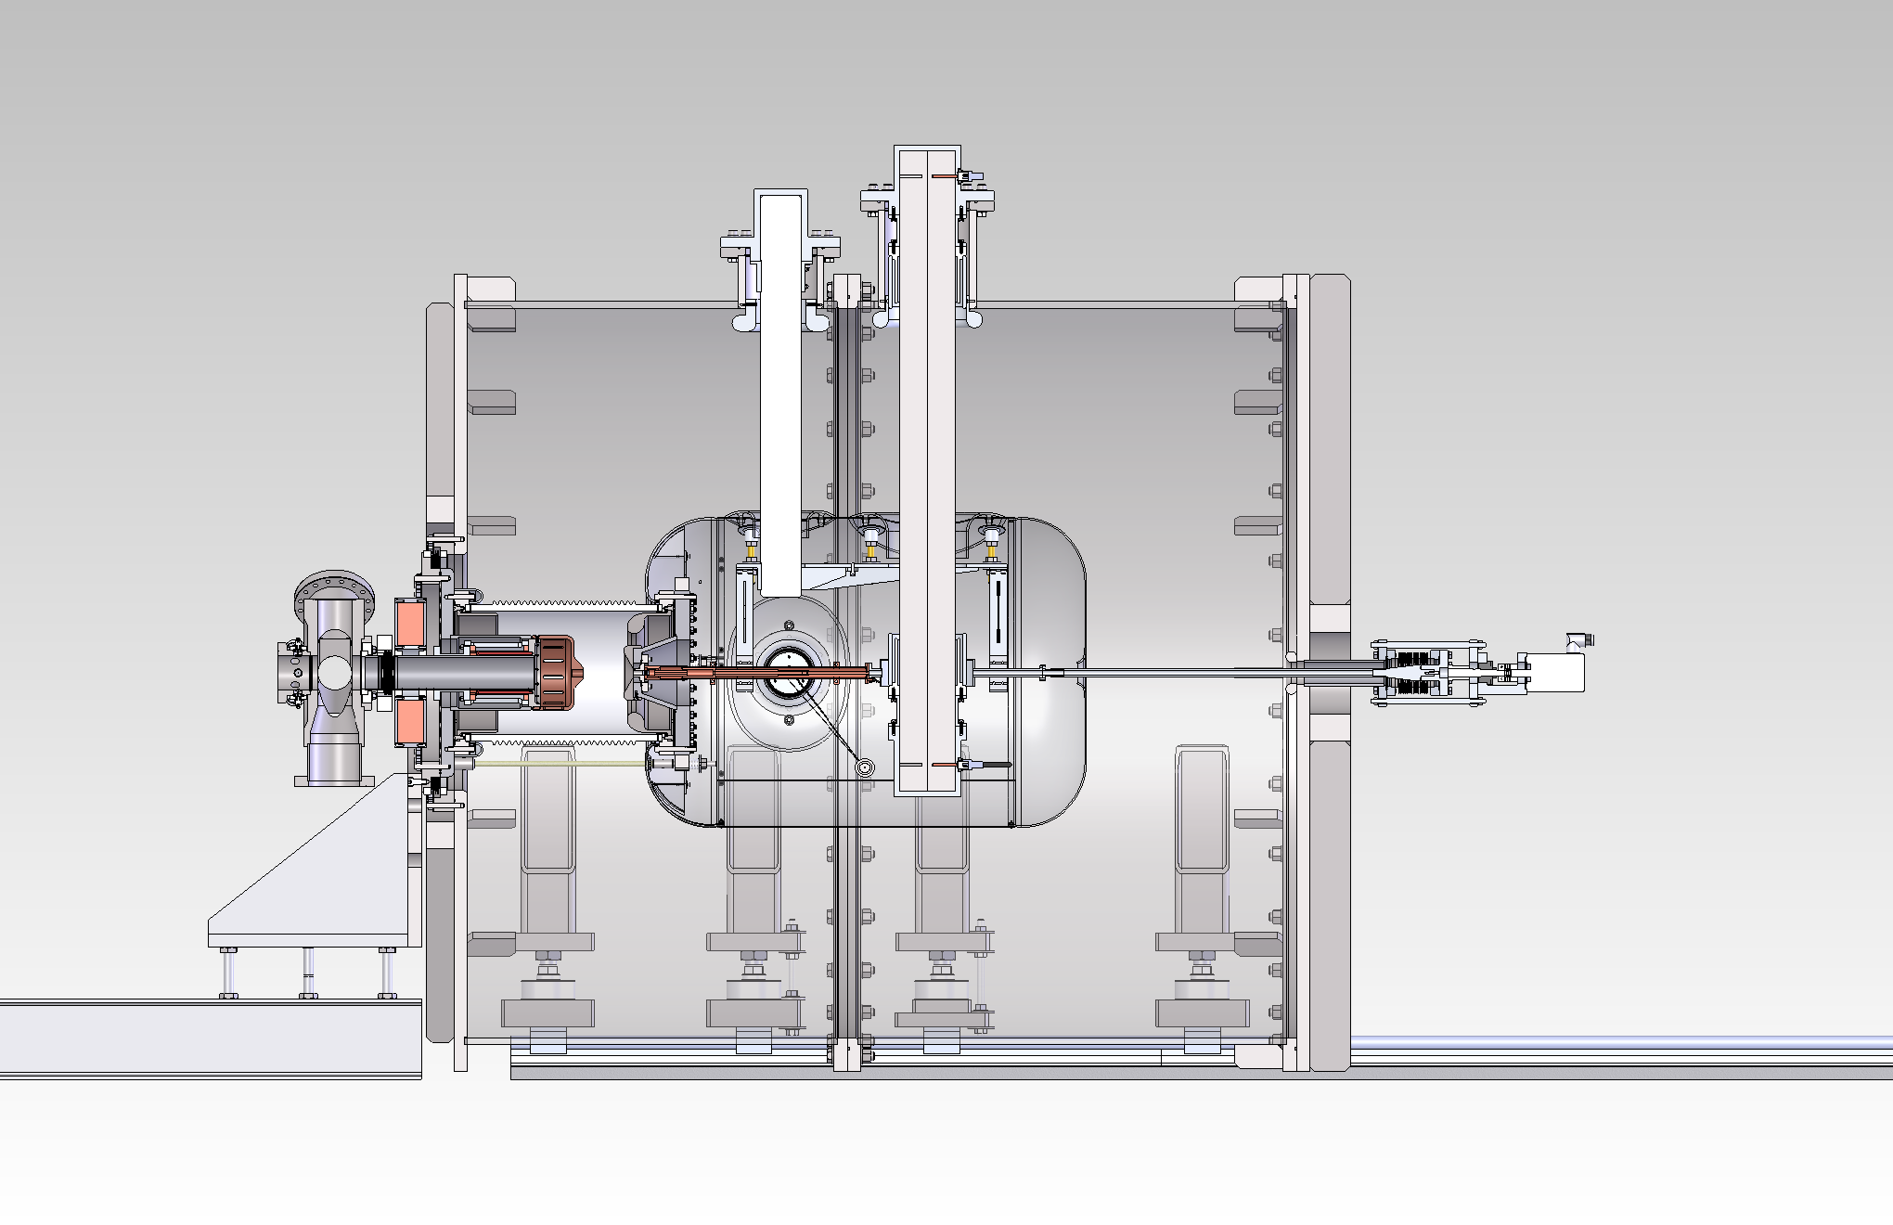
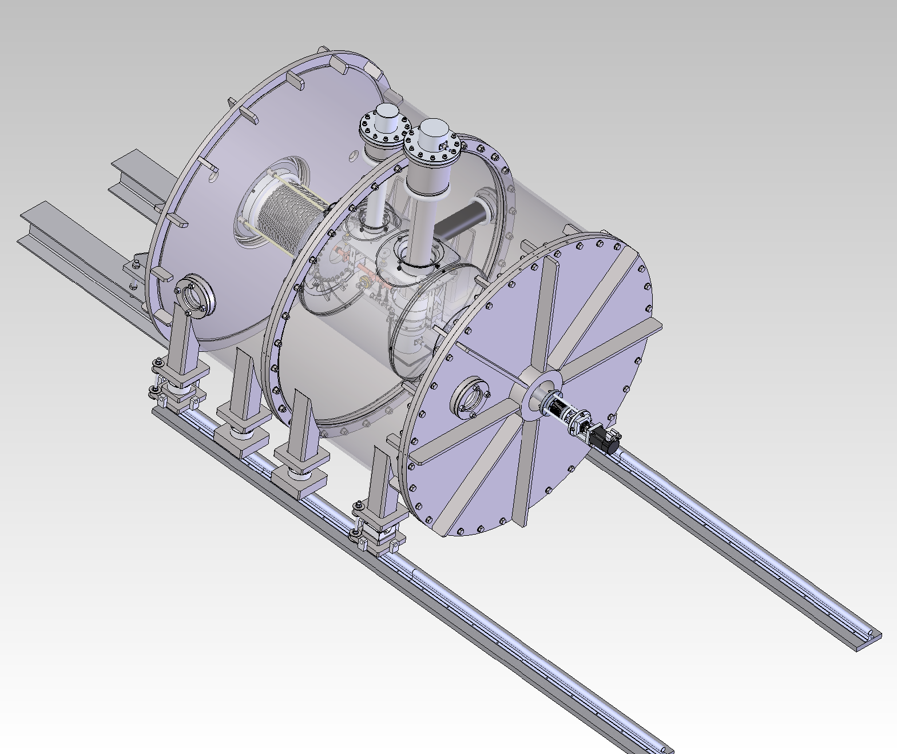
300 kV source design
SF₆ vessel
high voltage feedthrough
support
ceramic waveguide
high voltage shroud
rf tuner

Slide 15
ceramic rf waveguide
problem:
rf power is needed on high voltage
generator / amplifier on high voltage | generator / amplifier on ground
easy matching | easy operation and maintenance
high volume and power on high voltage | high voltage dc break for rf not commercially available
operating electronics in SF6 | higher rf losses in transport
first tests with rf transformer: not enough isolation or too high losses

Slide 16
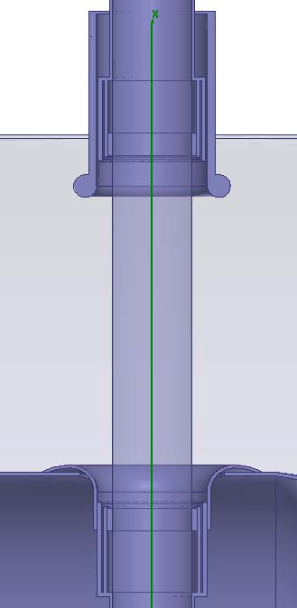
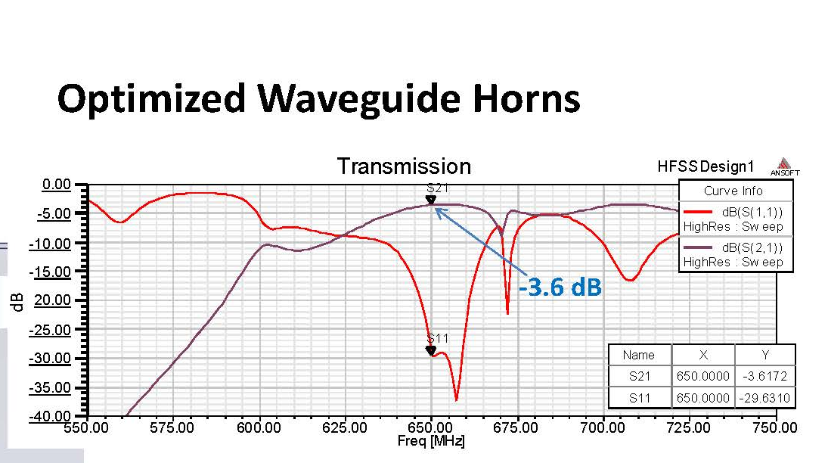
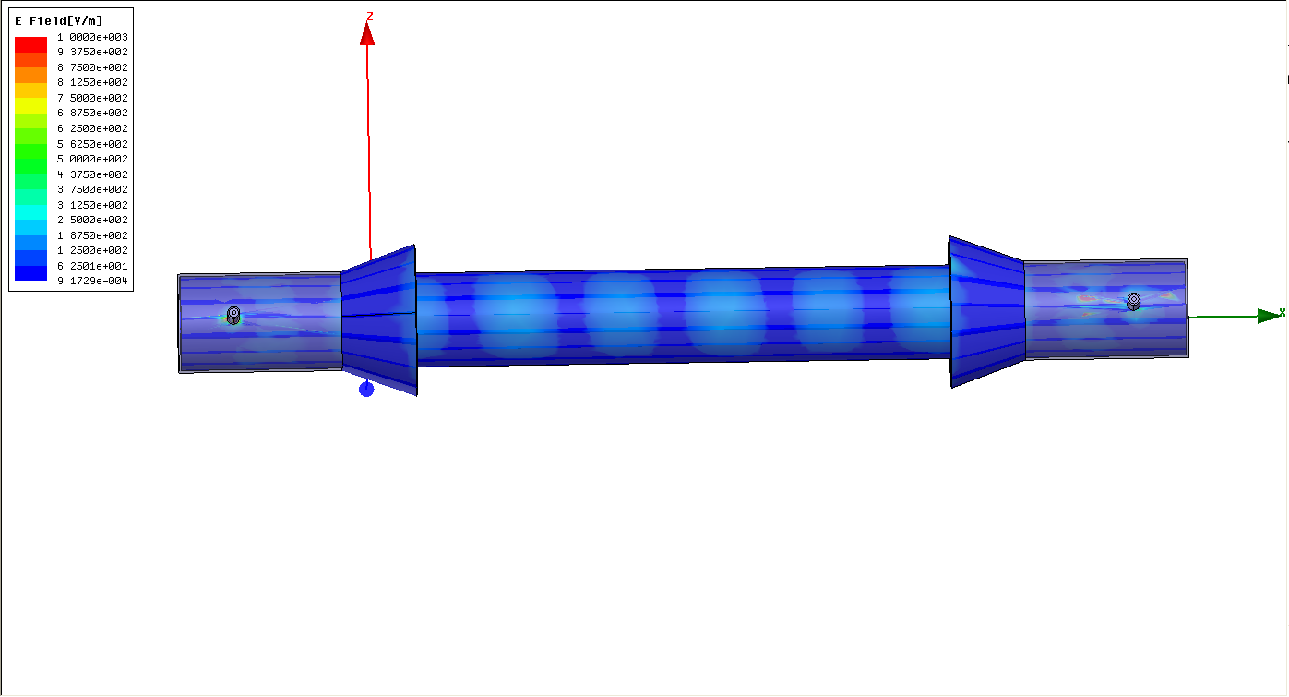
ceramic rf waveguide
Al₂O₃ ceramic Ø 10 cm
HFSS simulation

Slide 17
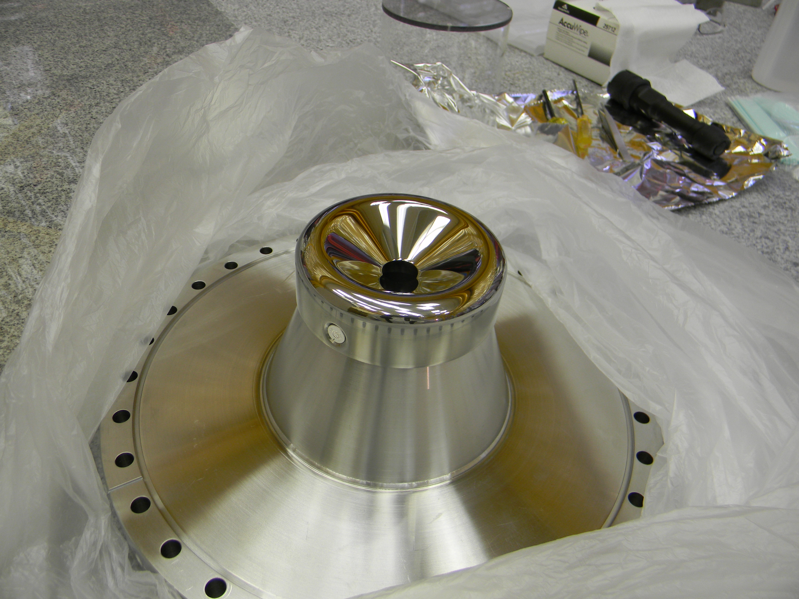
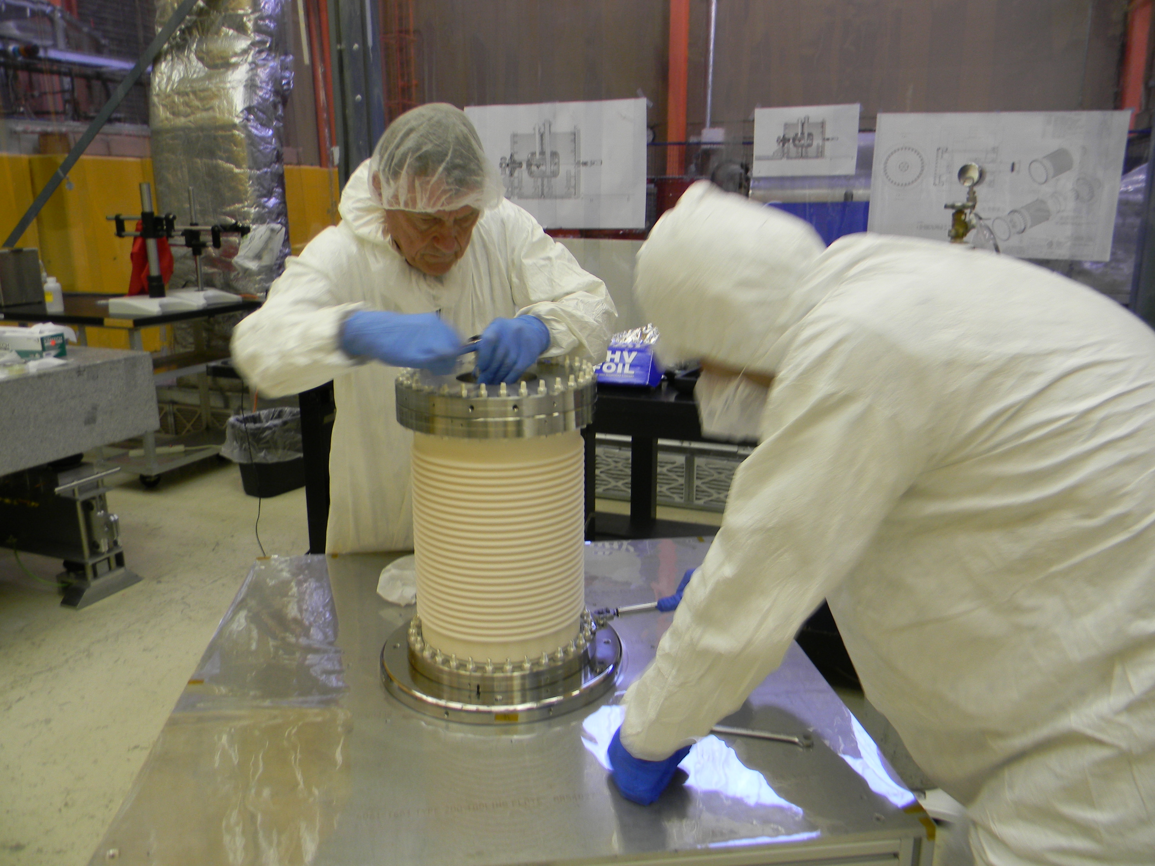
titanium
Pierce electrode
copper beryllium
anode in ceramic
preparing for leak check

Slide 18
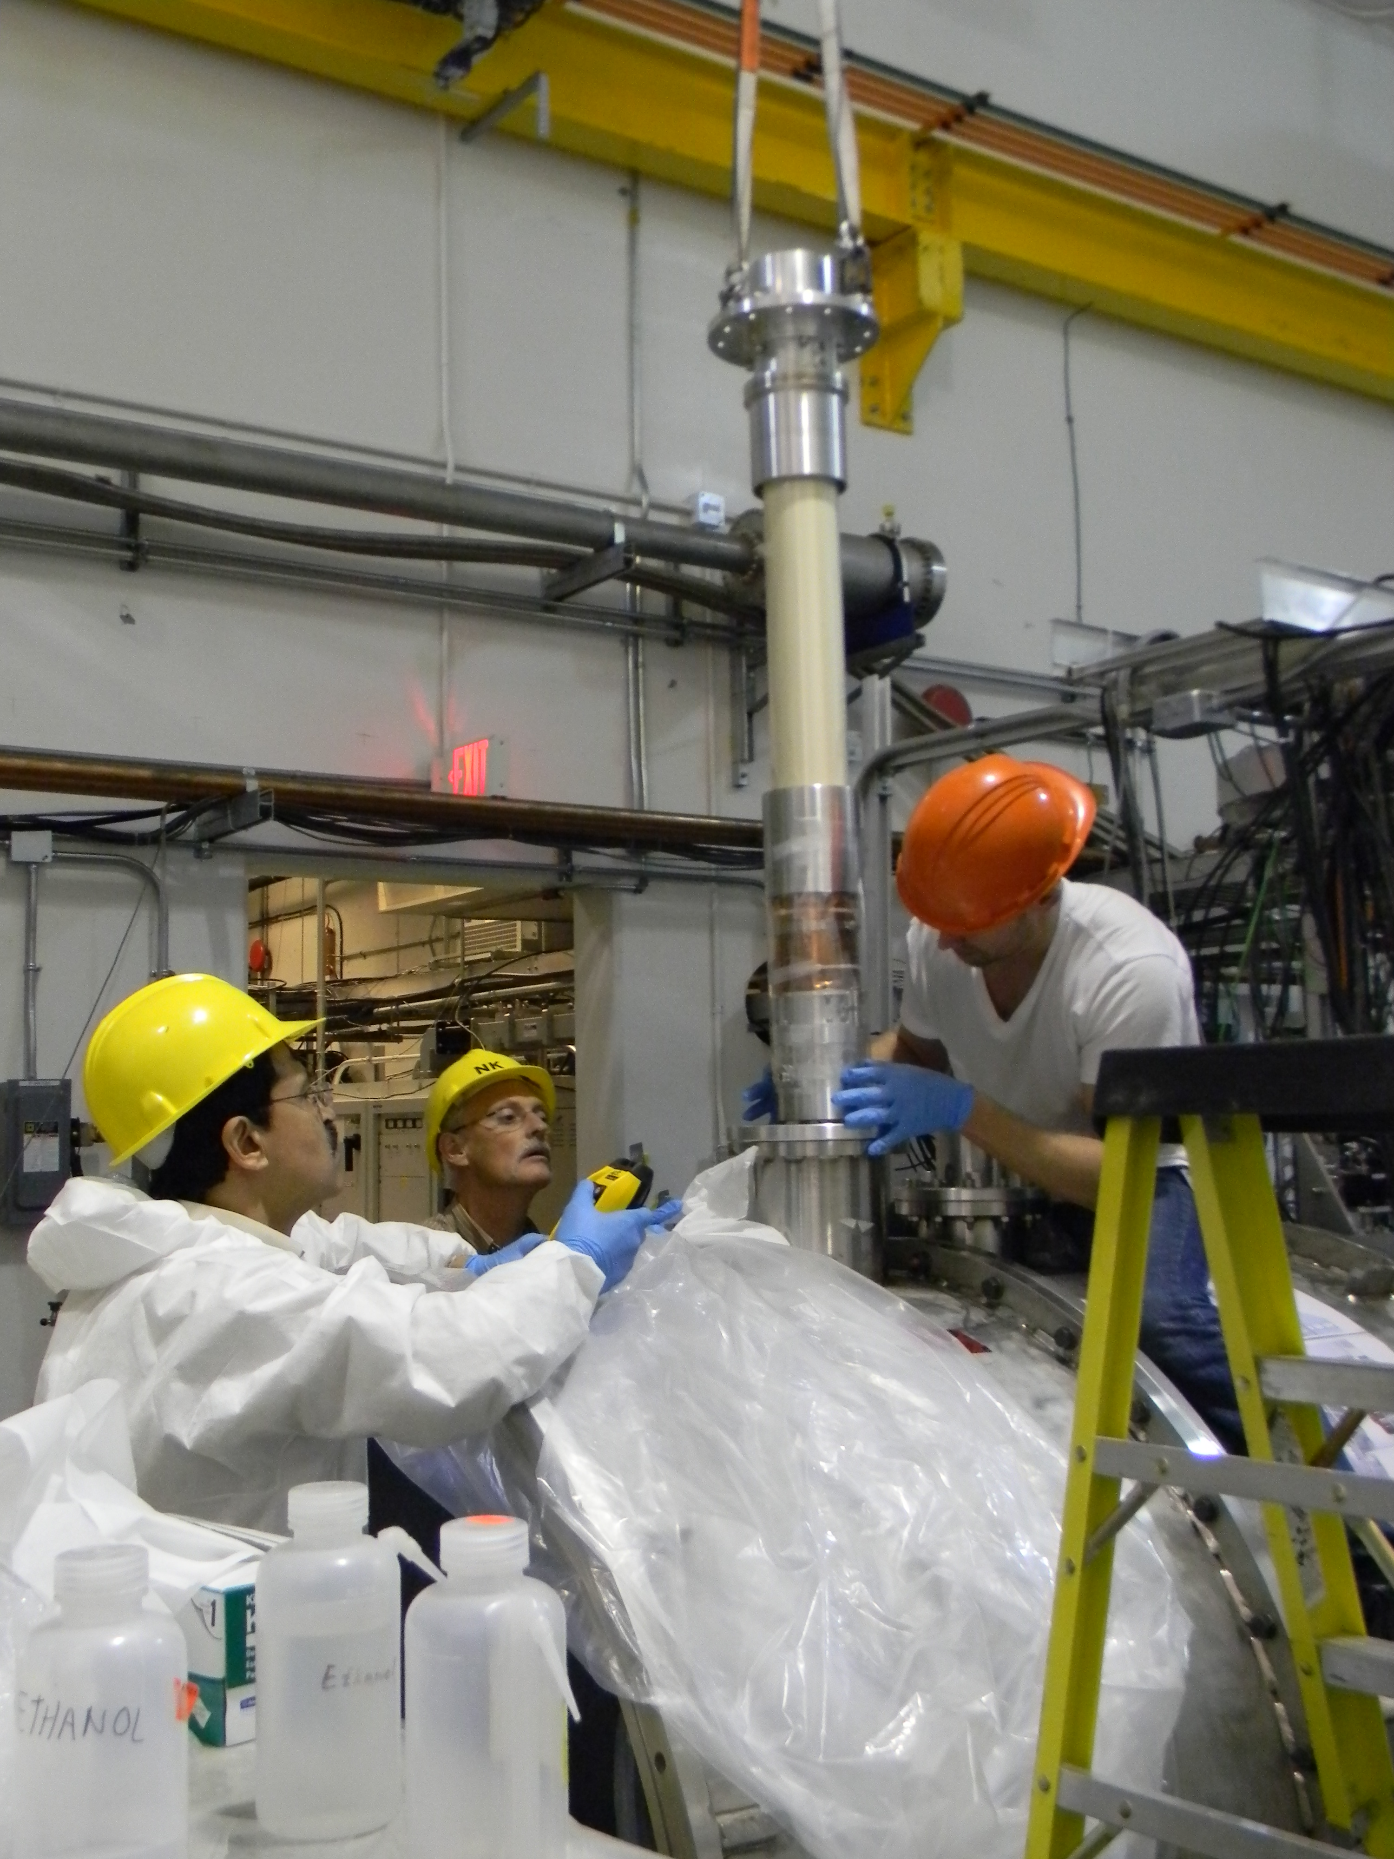
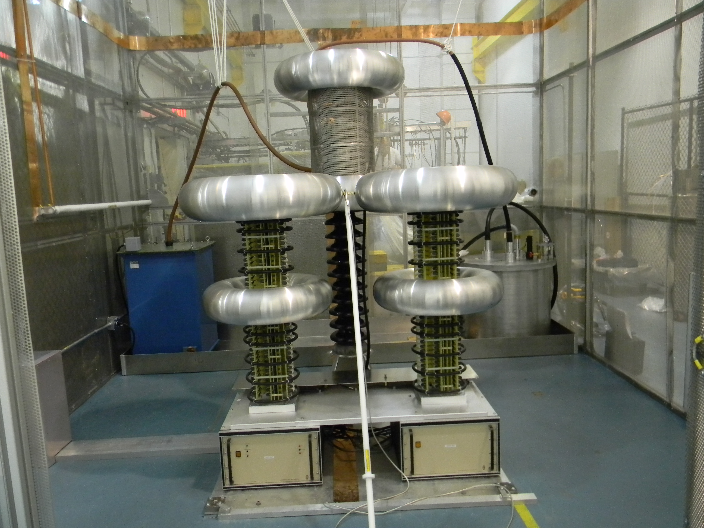
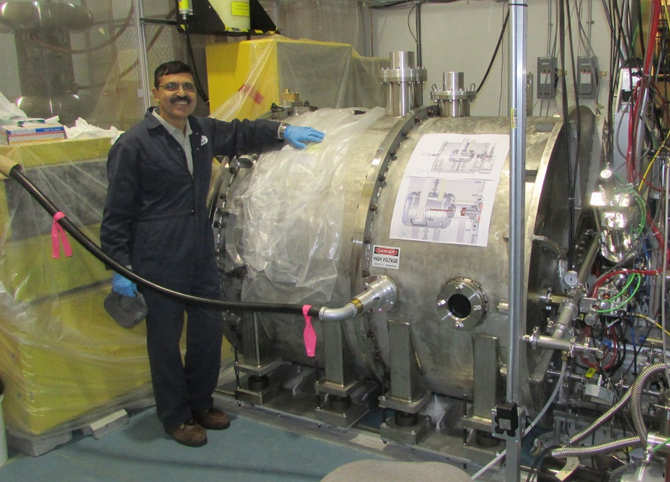
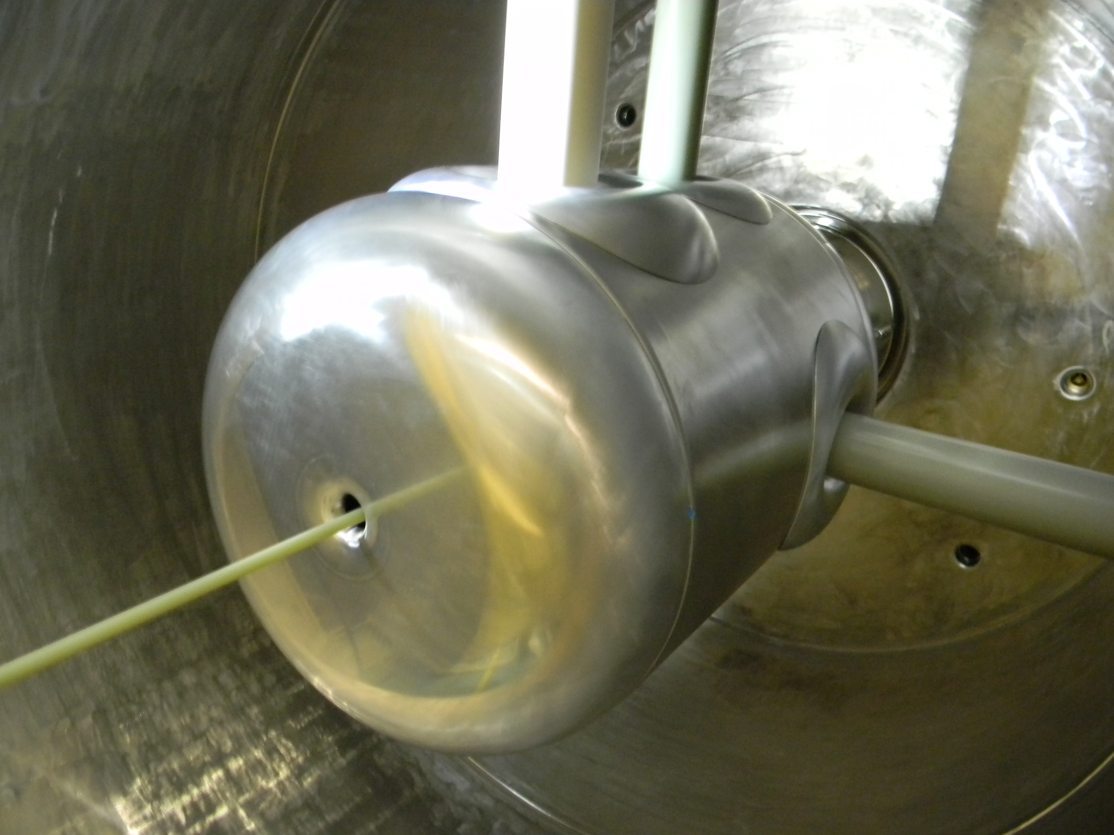
300 kV source installation
ceramic waveguide
350 kV, 16 mA
power supply
SF₆ vessel inside
SF₆ vessel outside

Slide 19
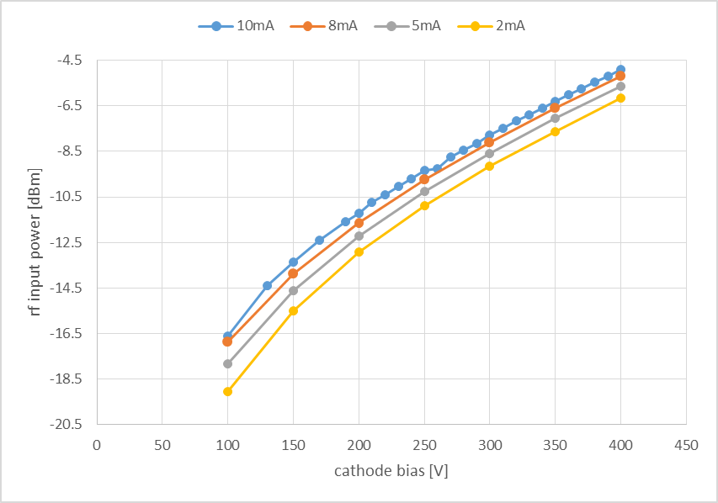
300 kV source results
Frist test with ceramic waveguide and 300 kV
Duty factor 0.1% (1 µs, 1 kHz)
Peak current 2-10 mA

Slide 20
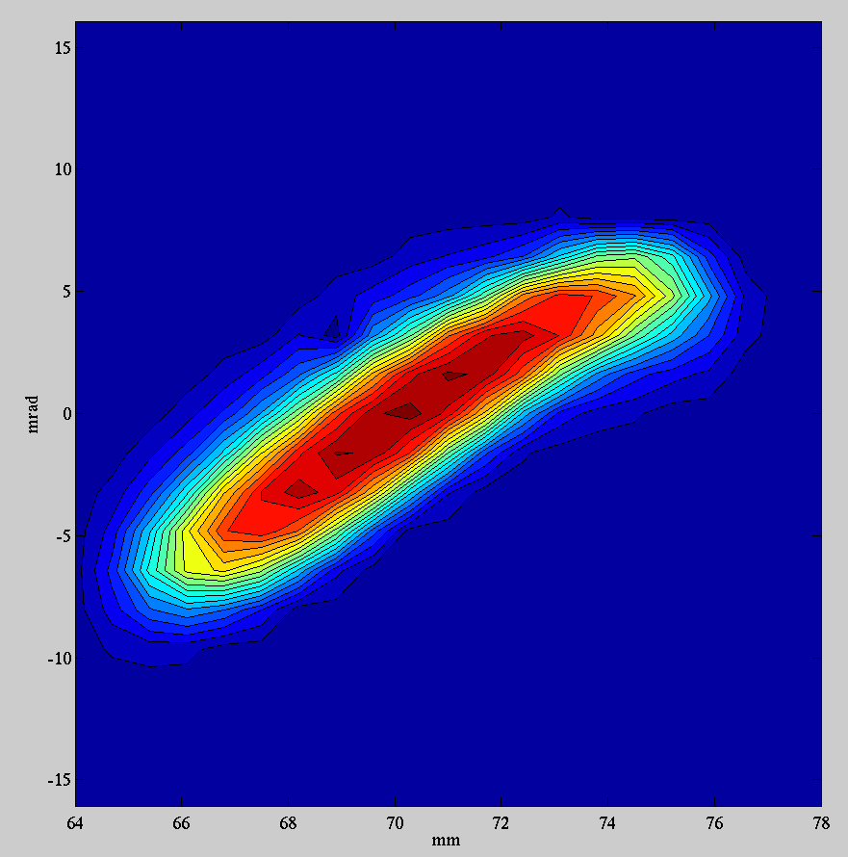
results
Duty factor =1%
average current = 100 μA
pulse current 10 mA
Power = 30 W
ε_{rms,norm}=7.5 μm

Slide 21
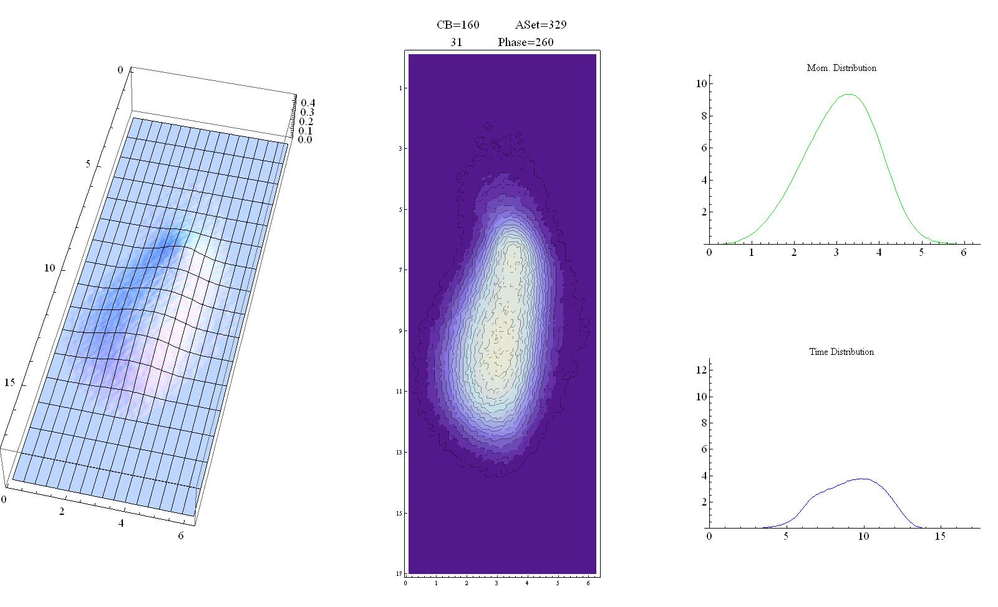
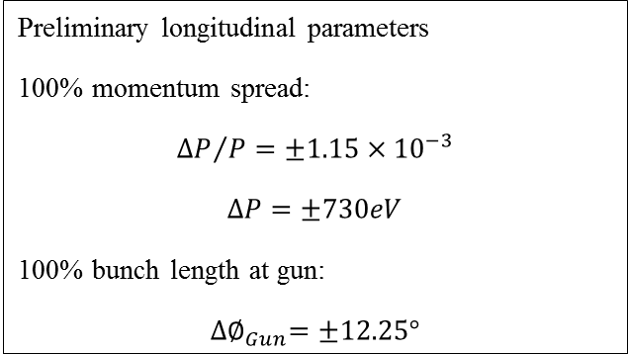
longitudinal emittance
Preliminary longitudinal parameters
100% momentum spread:
$${∆P}/P=±1.15×{10}^{−3}$$
$$∆P=±730eV$$
100% bunch length at gun:
$${∆∅}_{Gun}=±12.25°$$

Slide 22
summary
A 300 kV electron source has been installed for the ARIEL project at TRIUMF
Rf modulation of the gridded thermionic source has been demonstrated
A ceramic waveguide for the transportation of rf power has been used
Average current of the source is up to 10 mA
Macro pulsing (100Hz-10kHz) allows a duty factor of 0.1-100%
Outlook:
Injection into first accelerator cavity (10MeV) May 2014
Acknowledgement:
Many thanks to the electron source group of Jefferson laboratory
for providing us with the 100 kV prototype source body.

