Slide 1
Pictures from TRIUMF’s 300kV thermionic cathode RF grid gated electron gun
Carlos’ visit, Nov 20-21 2017

Slide 2
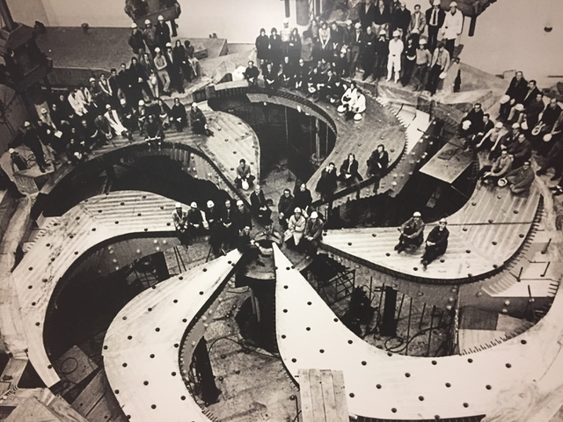
Behold, the Cyclotron!

Slide 3
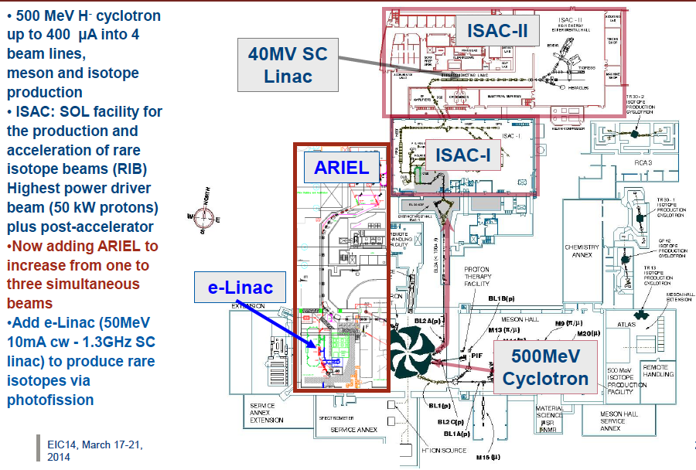

Slide 4
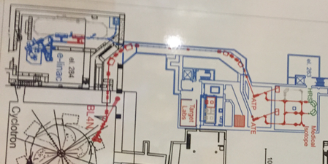
This is why they want a high brightness gun: Make THz or IR light!
Blue: e-LINAC with present 300kV pulsed RF gun

Slide 5
Gun cross section (F. Ames, et al, LINAC 2016)

Slide 6
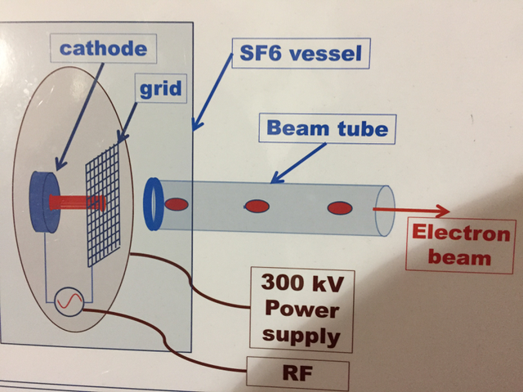
This is the concept of the thermionic grid RF gated gun

Slide 7
Bunch extraction scheme using RF gated grid

Slide 8
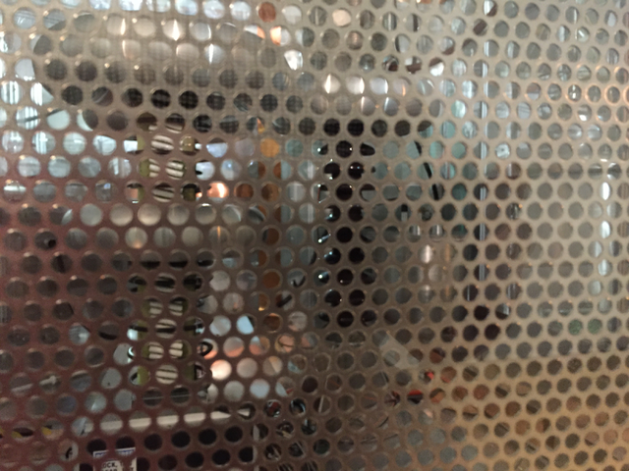
Glassman HVPS inside a Faraday cage

Slide 9
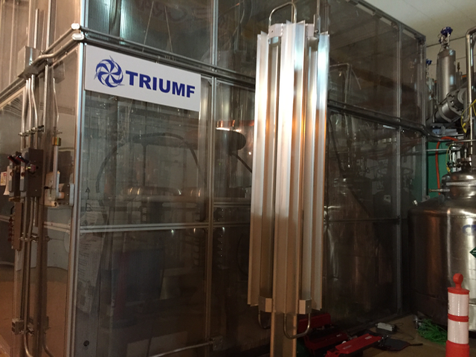
The cable connecting the HVPS to the gun is stripped of the ground shield to minimize stored energy

Slide 10
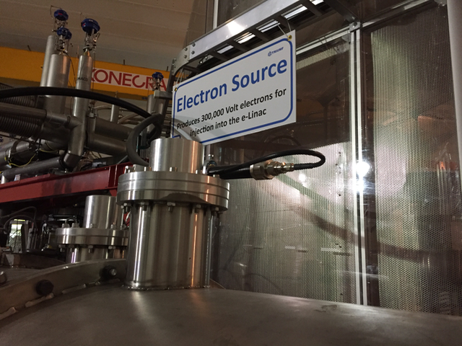
This is the RF input feed to the SF6 tank

Slide 11
Gun ceramic insulator and ceramic rod RF waveguide

Slide 12
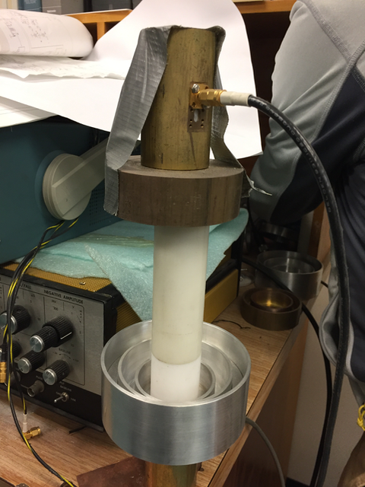
RF is transmitted through a solid ceramic rod, this is a 1/3 scale test using nylon!

Slide 13
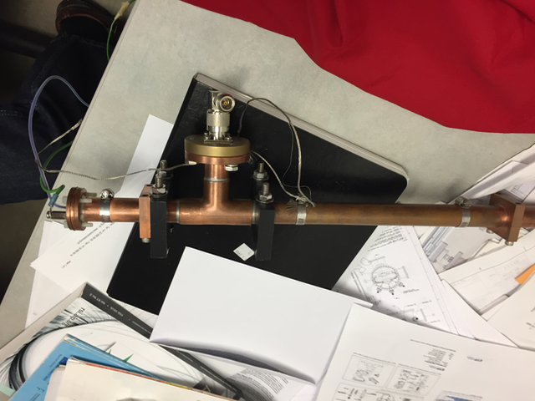
Gun RF tuner feed, it’s complicated…has three internal ‘transformers’ to manage reflections back to the power supplies
RF input
Cathode PS
RF to cathode

Slide 14
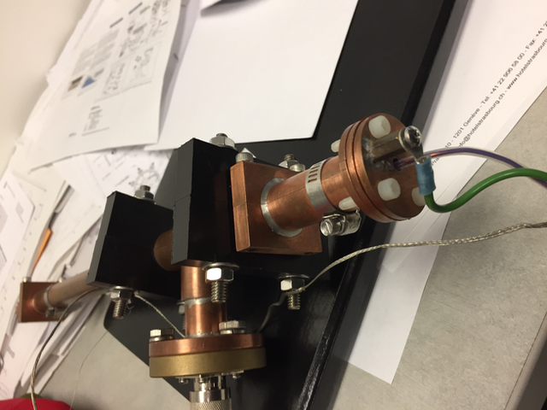

Slide 15
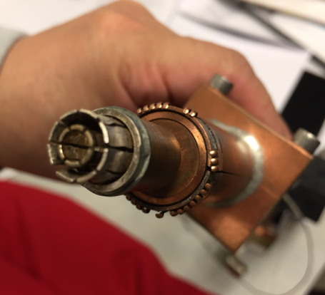
Coupling RF to the gridded cathode (grid, cathode power, and ground)
This connector plugs directly behind the thermionic cathode flange

Slide 16
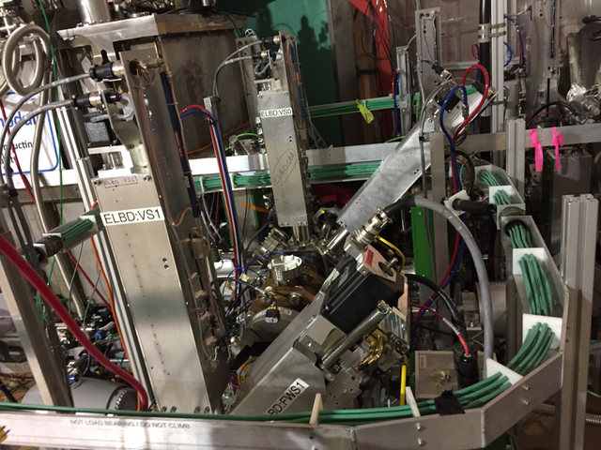
They use Helmholtz coils all around the beamline to compensate for the cyclotron’s B-field!

Slide 17
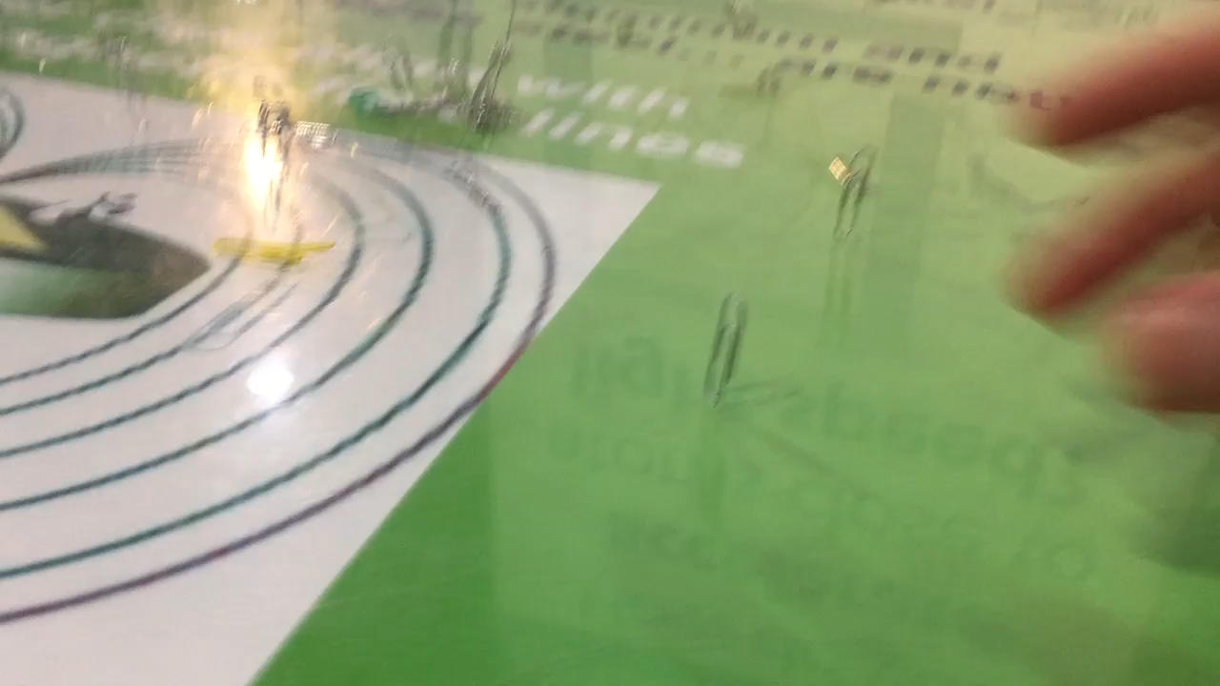
Magnetic field?...anyone?

Slide 18
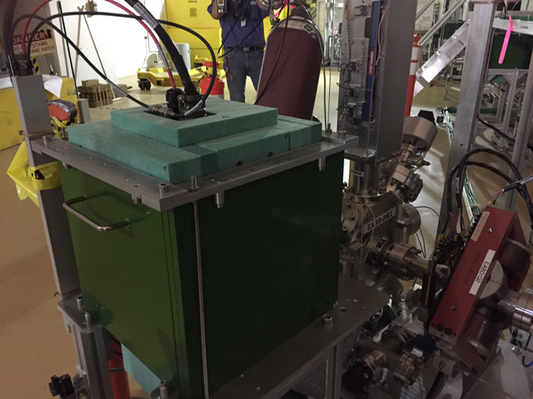
Shielding for viewer cameras

Slide 19
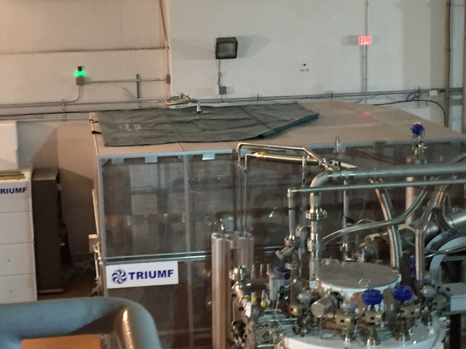
SF6 storage bag on top of the cage. SF6 set to 30 psi in the gun tank

Slide 20
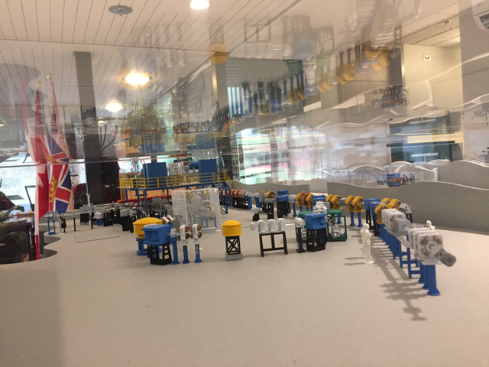
This is a miniature model of one of the user beamlines

Slide 21
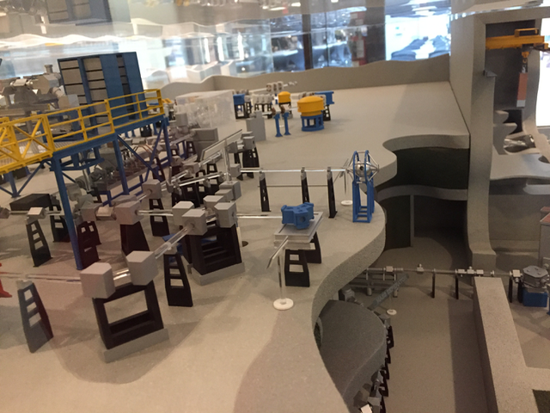
They deliver isotope beams at various elevations (miniature model)

Slide 22
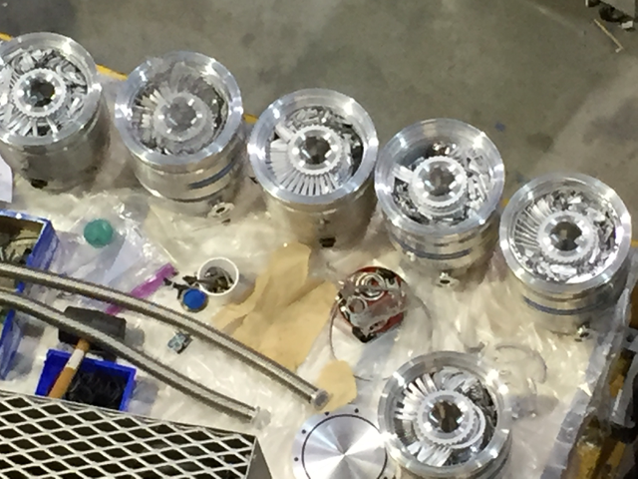
Don’t destroy the turbos!

Slide 23
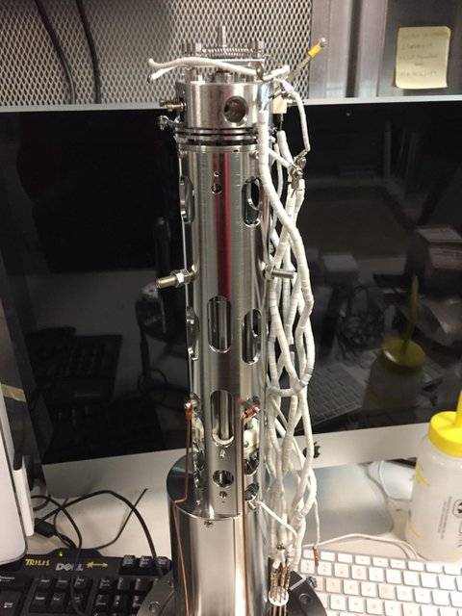
Mass spectrometer (RGA) up to 500 amu!?

Slide 24
